Slide 1
Azure Scale Out
Peter Cheung
Azure User Group

Slide 2
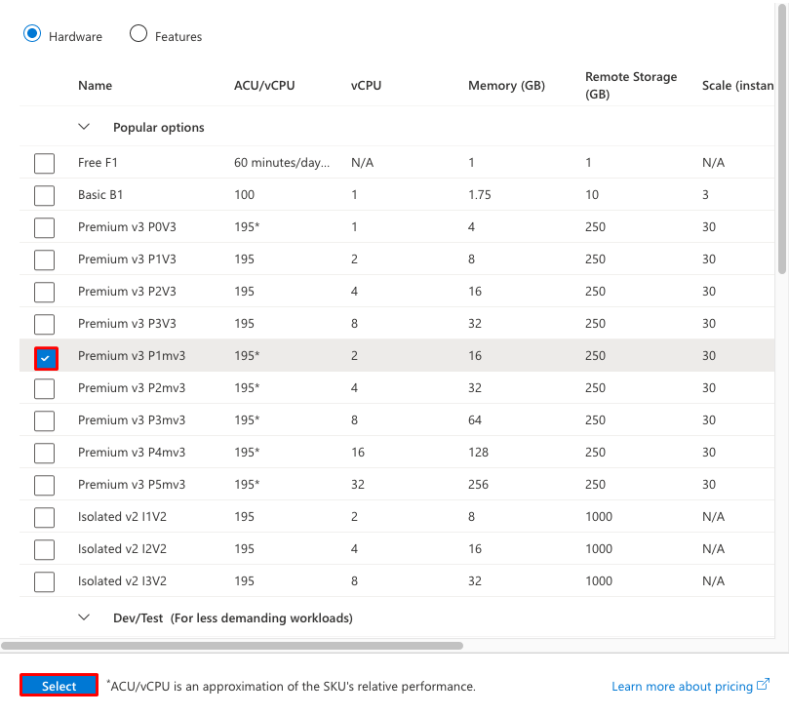
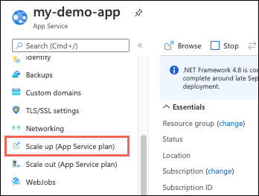
App Services – Scale up

Slide 3
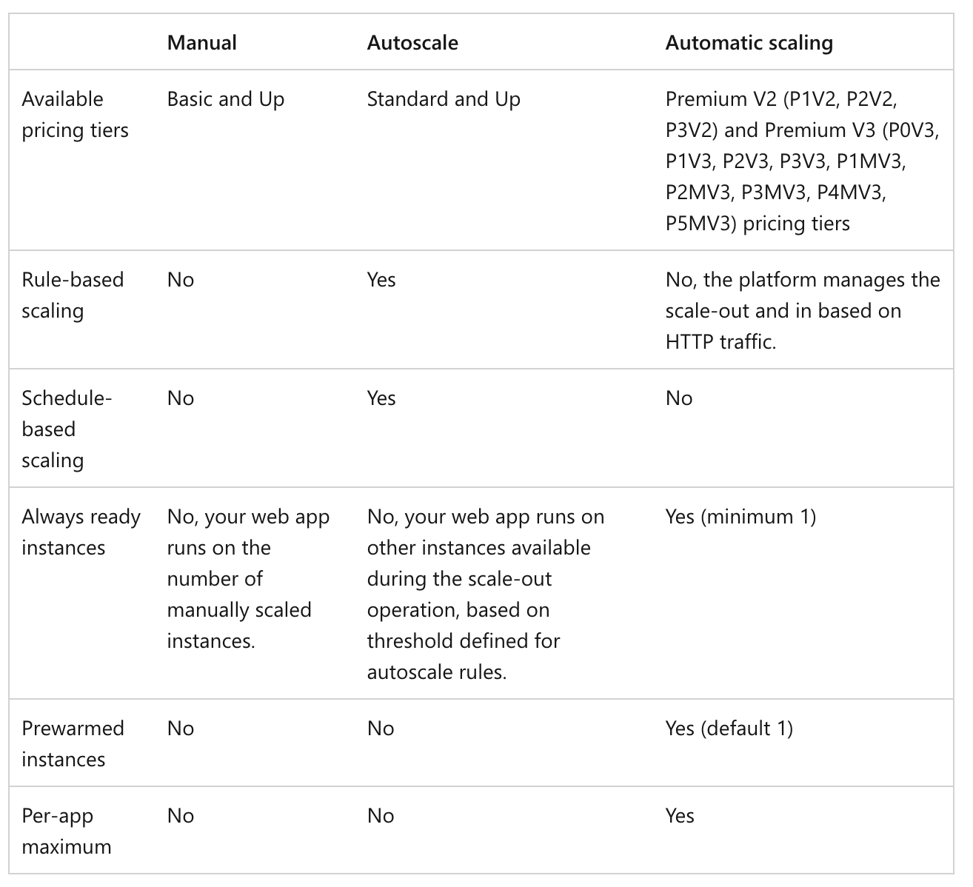
App Services
Scale out

Slide 4
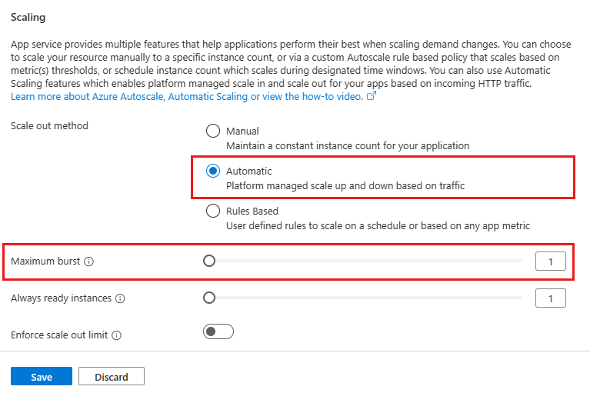

Slide 5
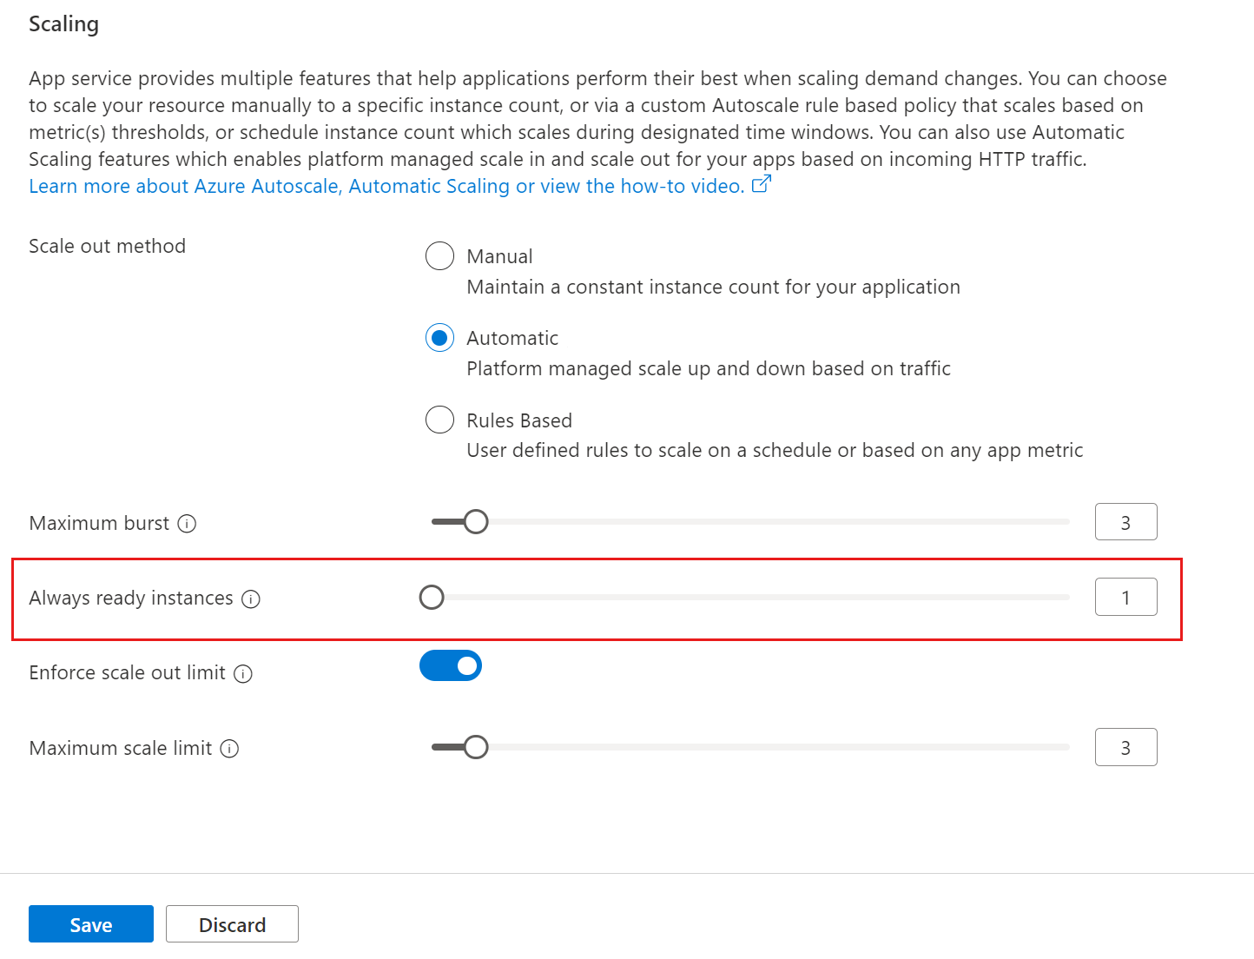
Set minimum number of web app instances

Slide 6
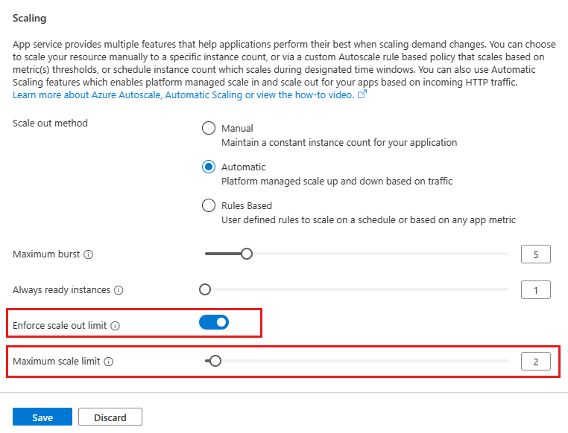
Set maximum number of web app instances

Slide 7
SQL Azure
Scale up & out

Slide 8
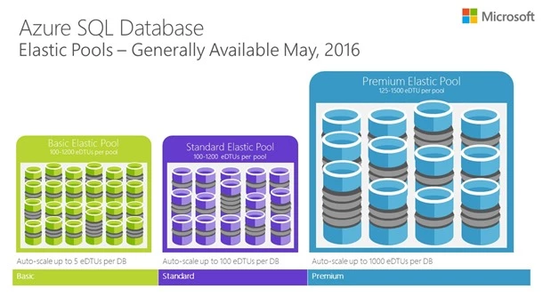
Basic Rules
With a single database, you can use either DTU or vCore models to define maximum amount of resources that will be assigned to each database.
Elastic pools enable you to define maximum resource limit per group of databases in the pool.

Slide 9
Alternative scale methods
Read scale-out is an available feature where you are getting one read-only replica of your data where you can execute demanding read-only queries such as reports. A read-only replica will handle your read-only workload without affecting resource usage on your primary database.
Database sharding is a set of techniques that enables you to split your data into several databases and scale them independently.

Slide 10
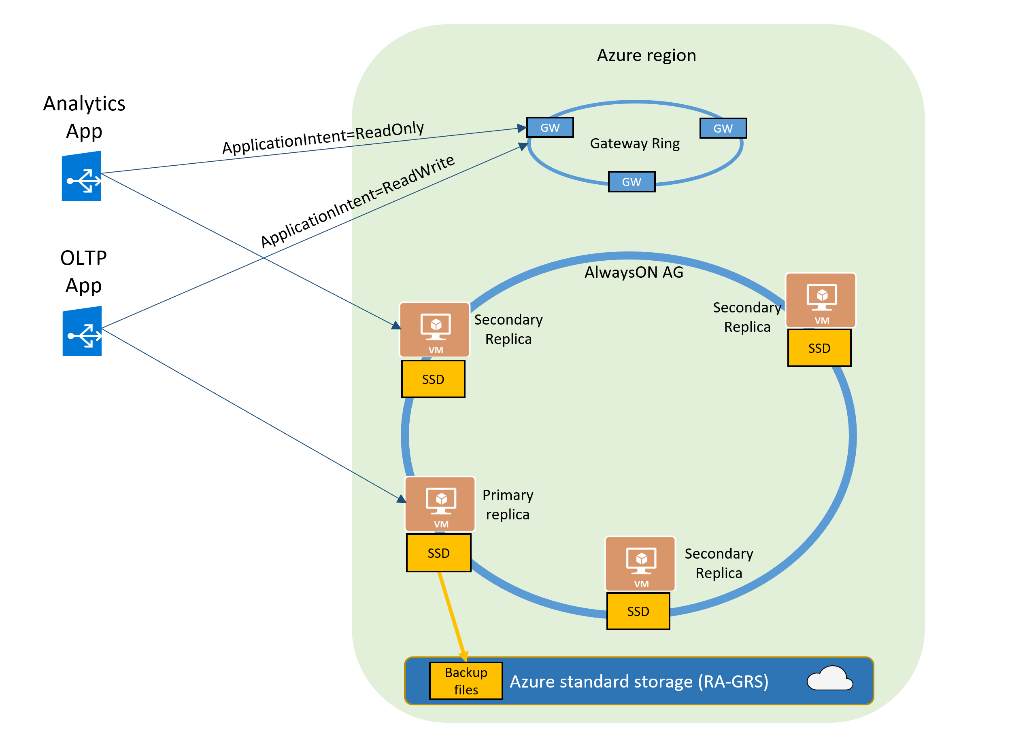

Slide 11
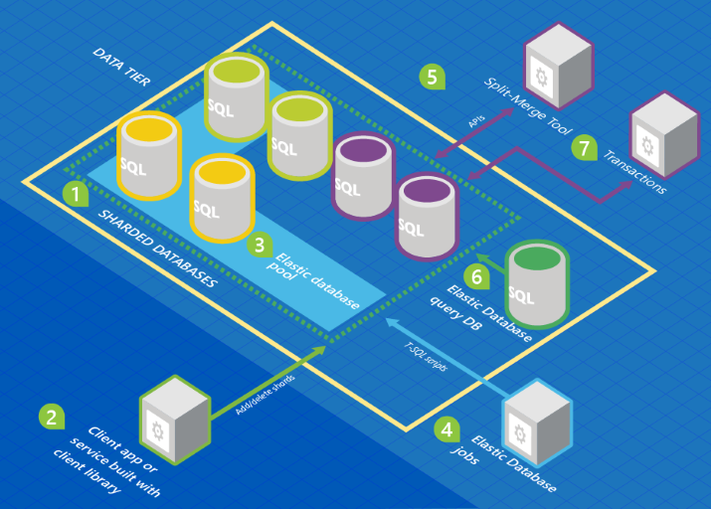
Database
sharding

