Slide 1
x86組合語言
第二堂

Slide 2
Macro - Preprocessor
NASM contains a powerful macro processor, which supports conditional assembly, multi-level file inclusion, two forms of macro (single-line and multi-line), and a `context stack' mechanism for extra macro power. Preprocessor directives all begin with a % sign.

Slide 3
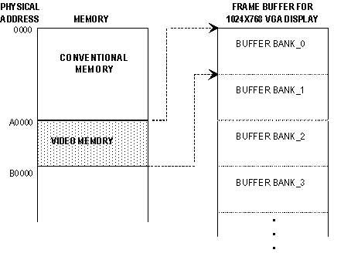
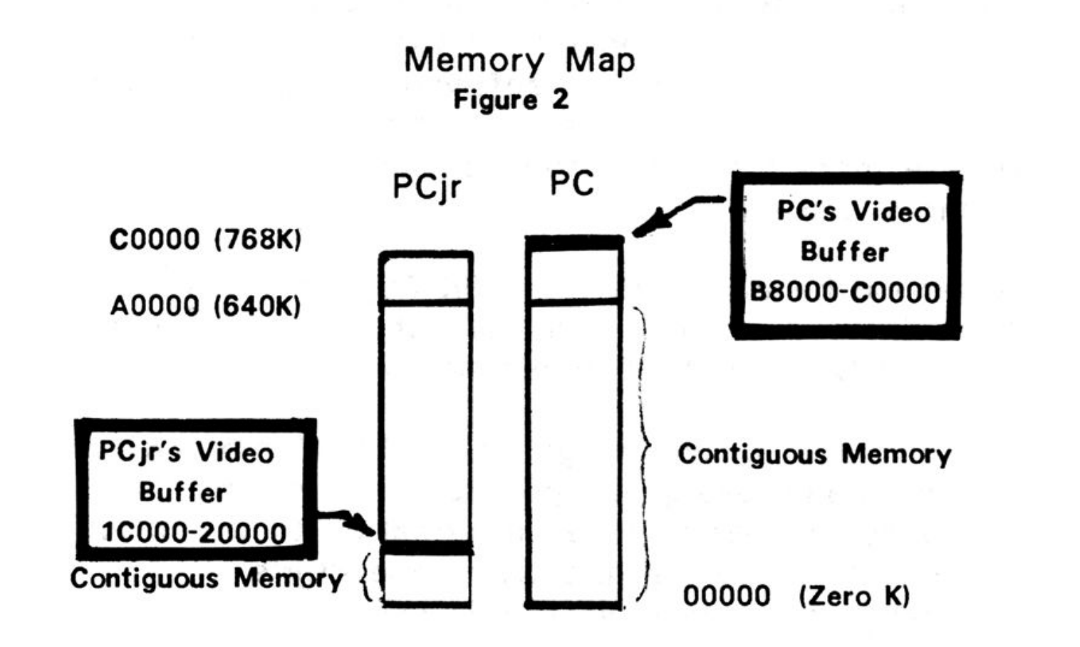
Framebuffer

Slide 4
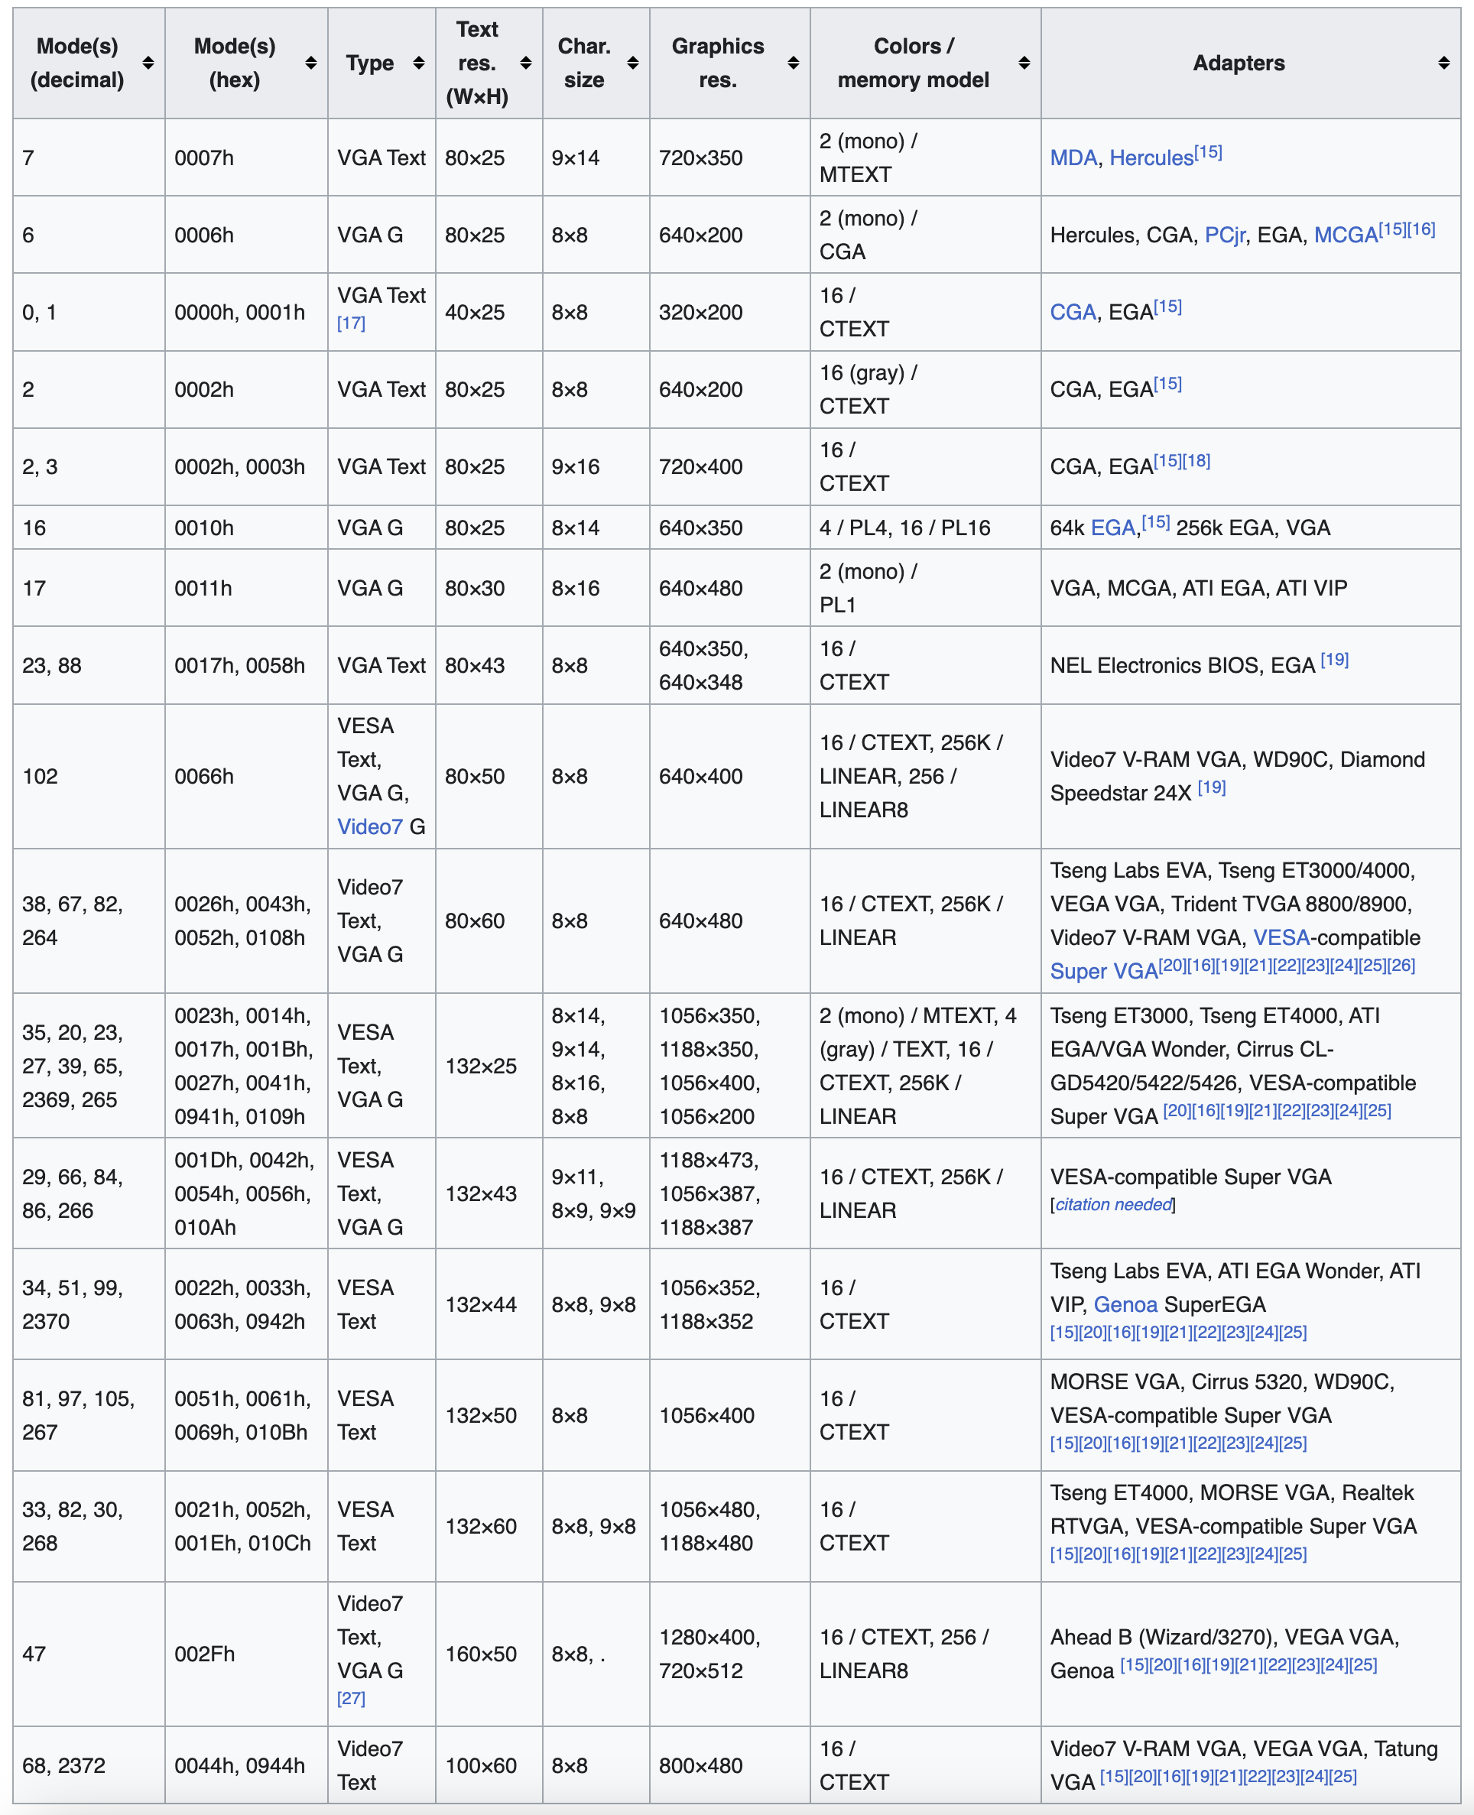
VGA Mode
https://en.wikipedia.org/wiki/VGA_text_mode

