Slide 1


Java第12堂
香港編程學會
Peter

Slide 2
Agenda
  Swing Layout
  XML
香港編程學會

Slide 3
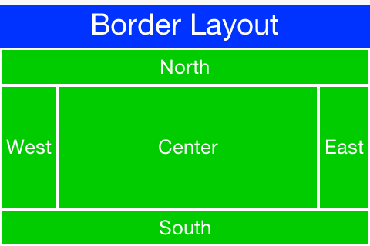
BorderLayout

Slide 4


Slide 5
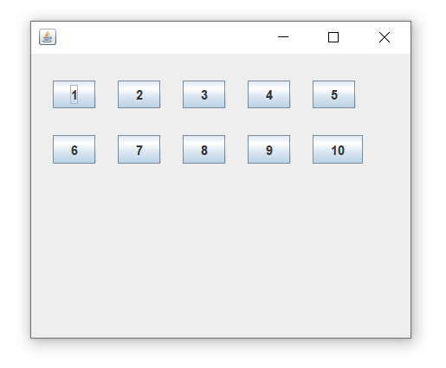
FlowLayout

Slide 6
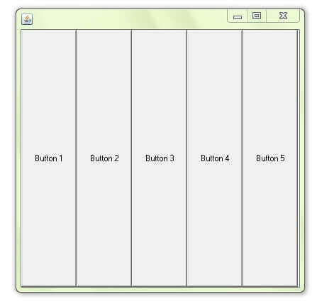
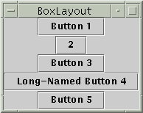
BoxLayout

Slide 7
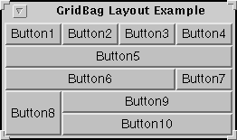
GridBagLayout

Slide 8
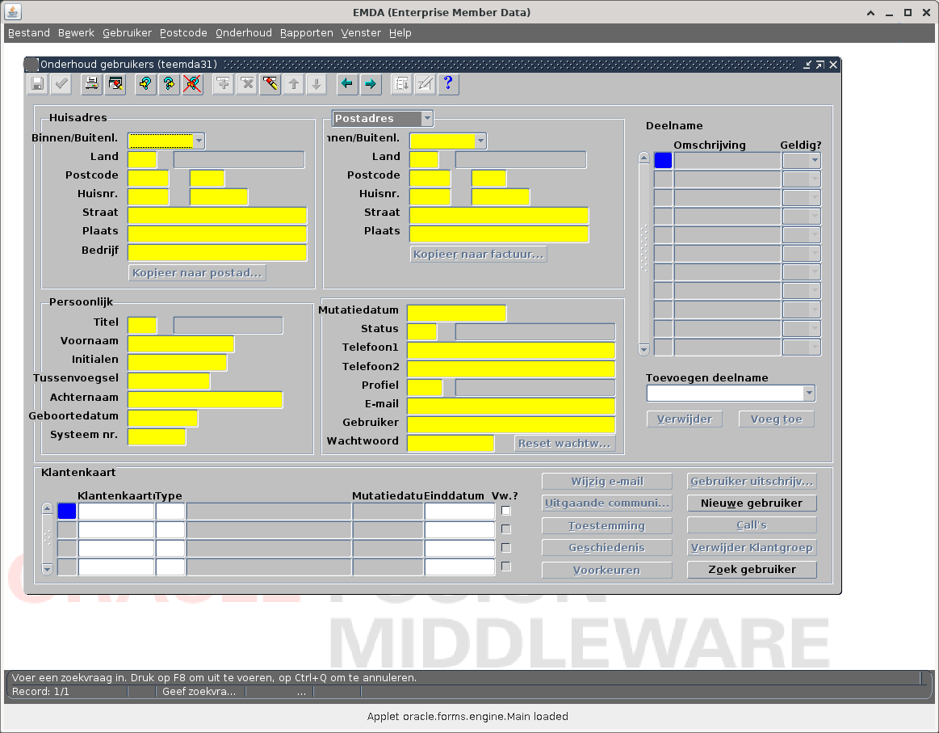

Slide 9

XML
XML stands for eXtensible Markup Language
XML is a markup language much like HTML
XML was designed to store and transport data
XML was designed to be self-descriptive
XML is a W3C Recommendation

Slide 10
How to learn right
Java DOM Parser
Java Xpath Parser

Slide 11
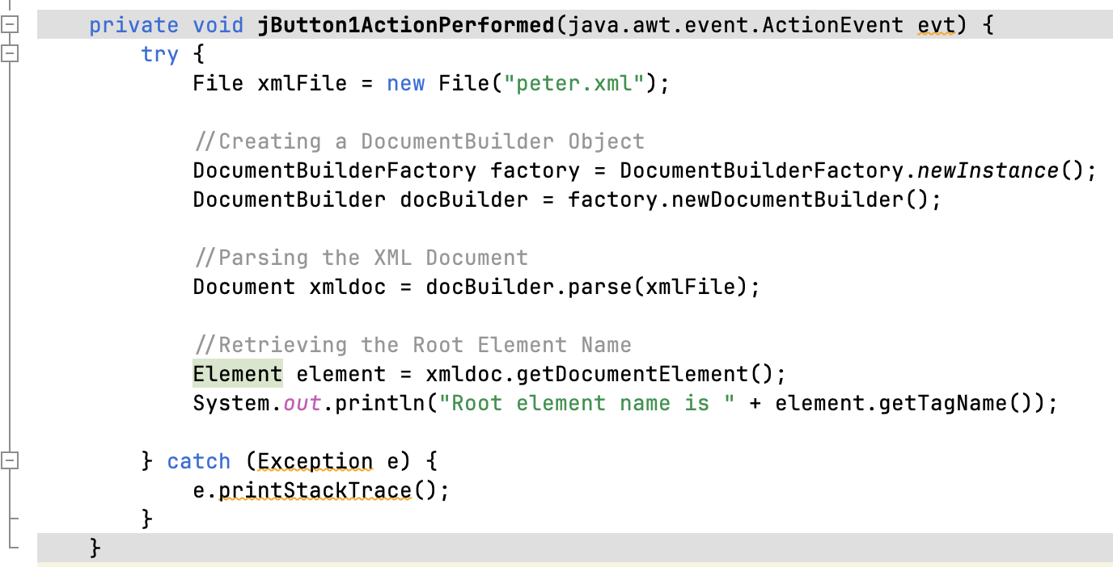
Read Root Node

Slide 12
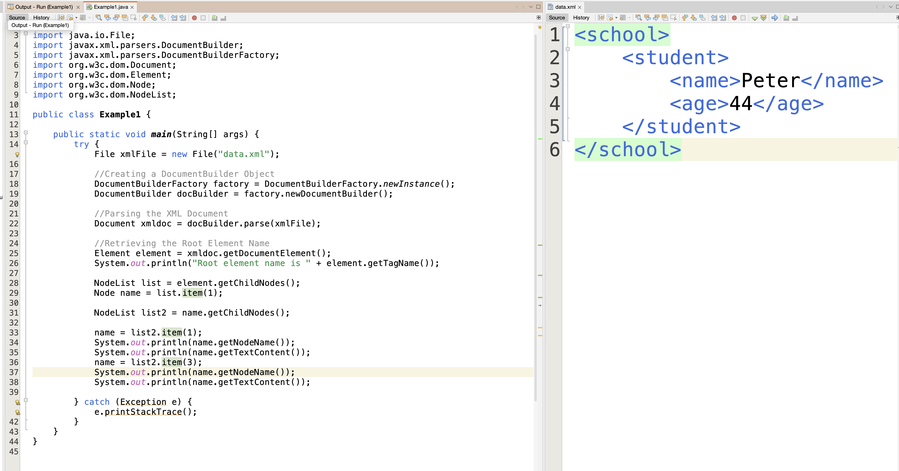

Slide 13
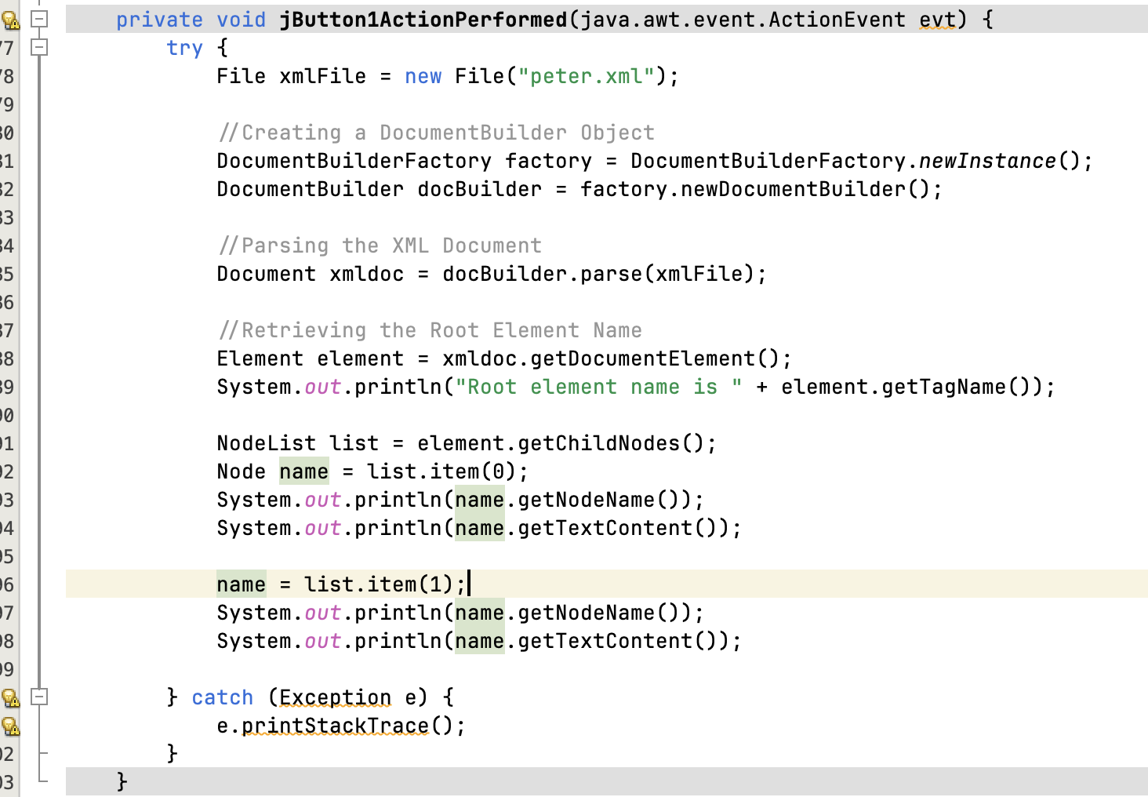
Get subnode

Slide 14
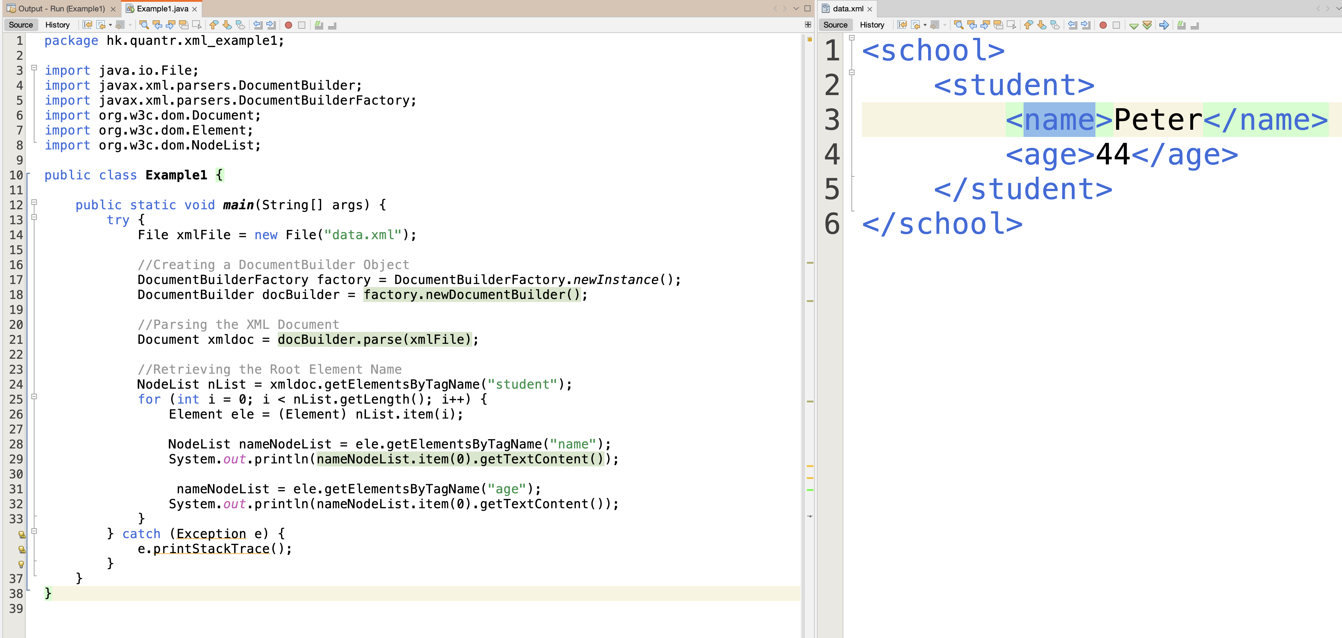

Slide 15
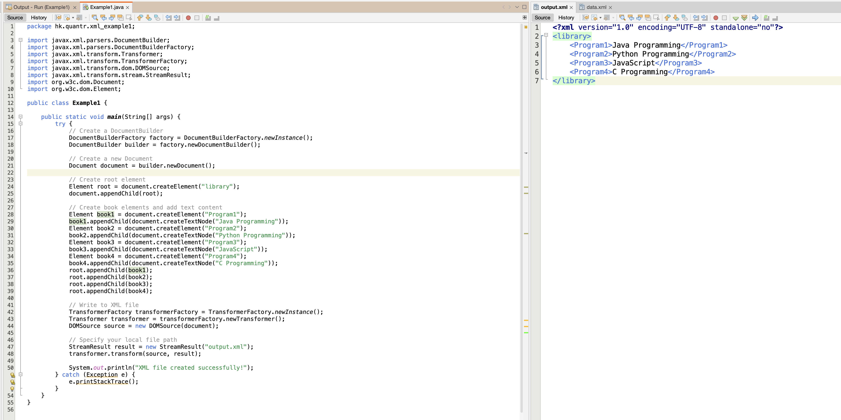
Write XML

Slide 16
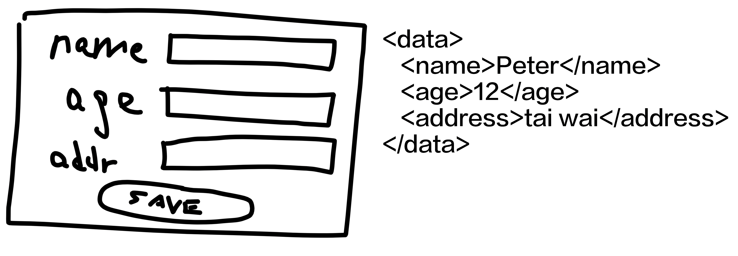
功課一 : Save XML

Slide 17
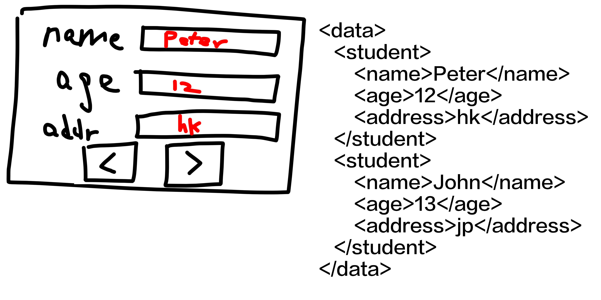
功課二：Load XML

Slide 18
Thank you
香港編程學會
Peter
96554595

