Slide 1


Java第13堂
香港編程學會
Peter

Slide 2
Agenda
  XPath
  XStream
香港編程學會

Slide 3
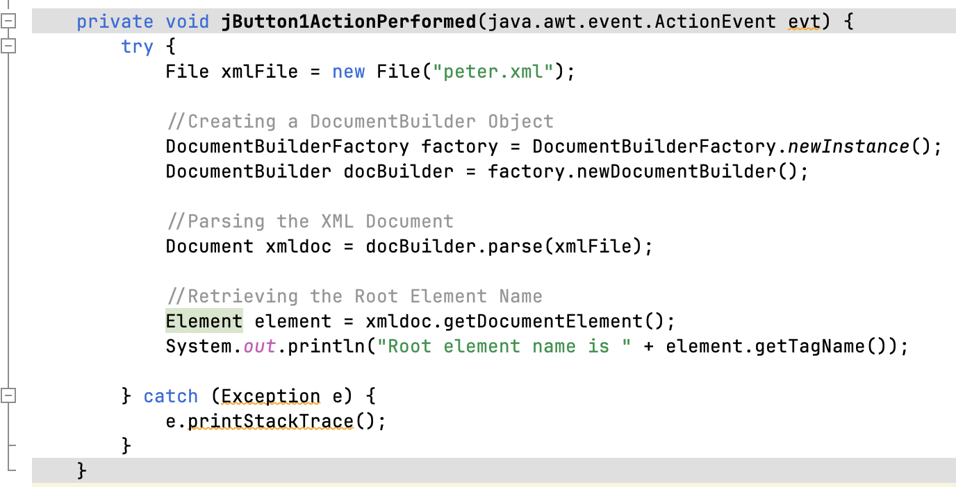
Read Root Node

Slide 4
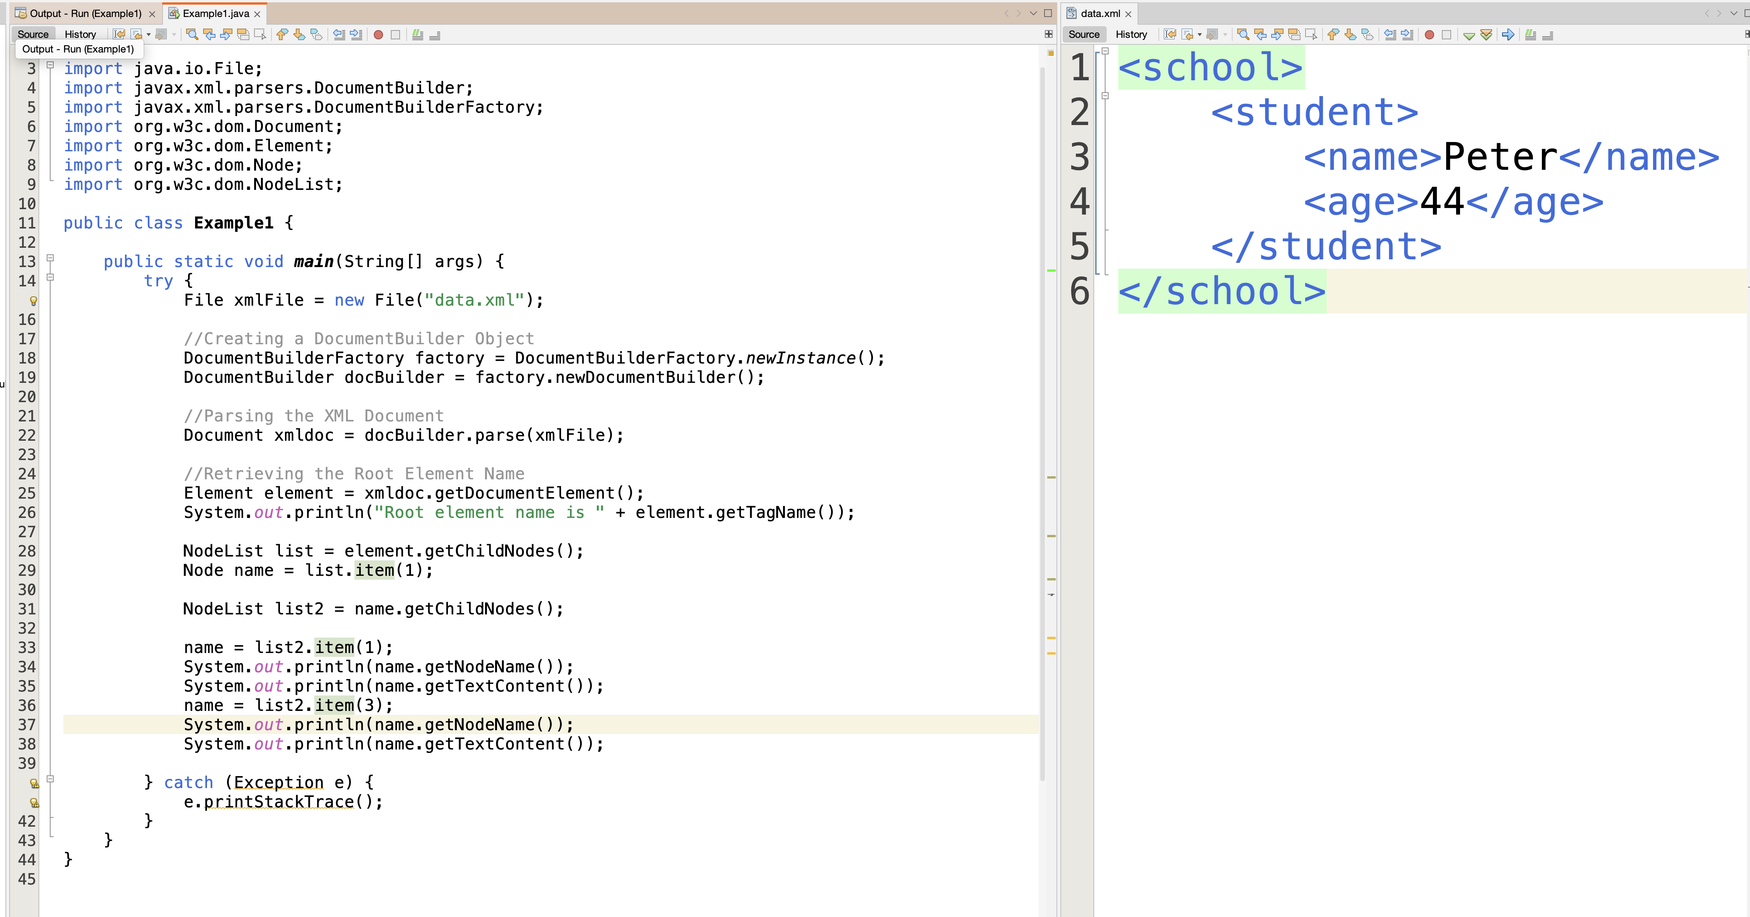

Slide 5
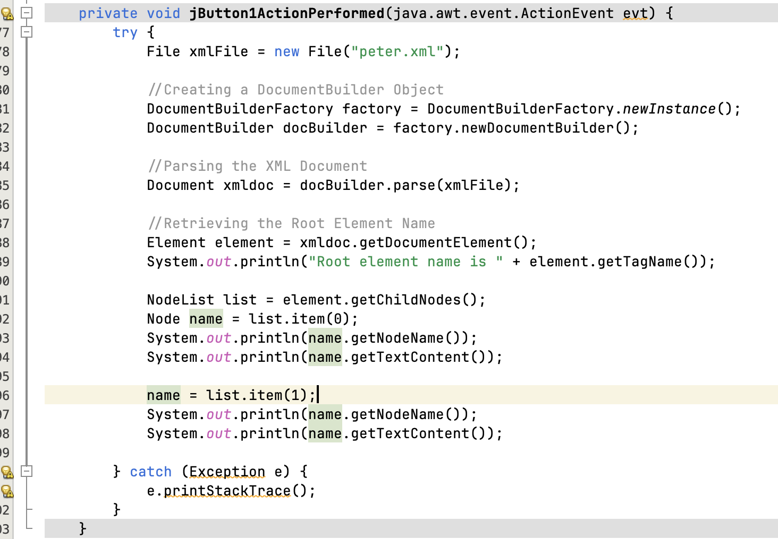
Get subnode

Slide 6
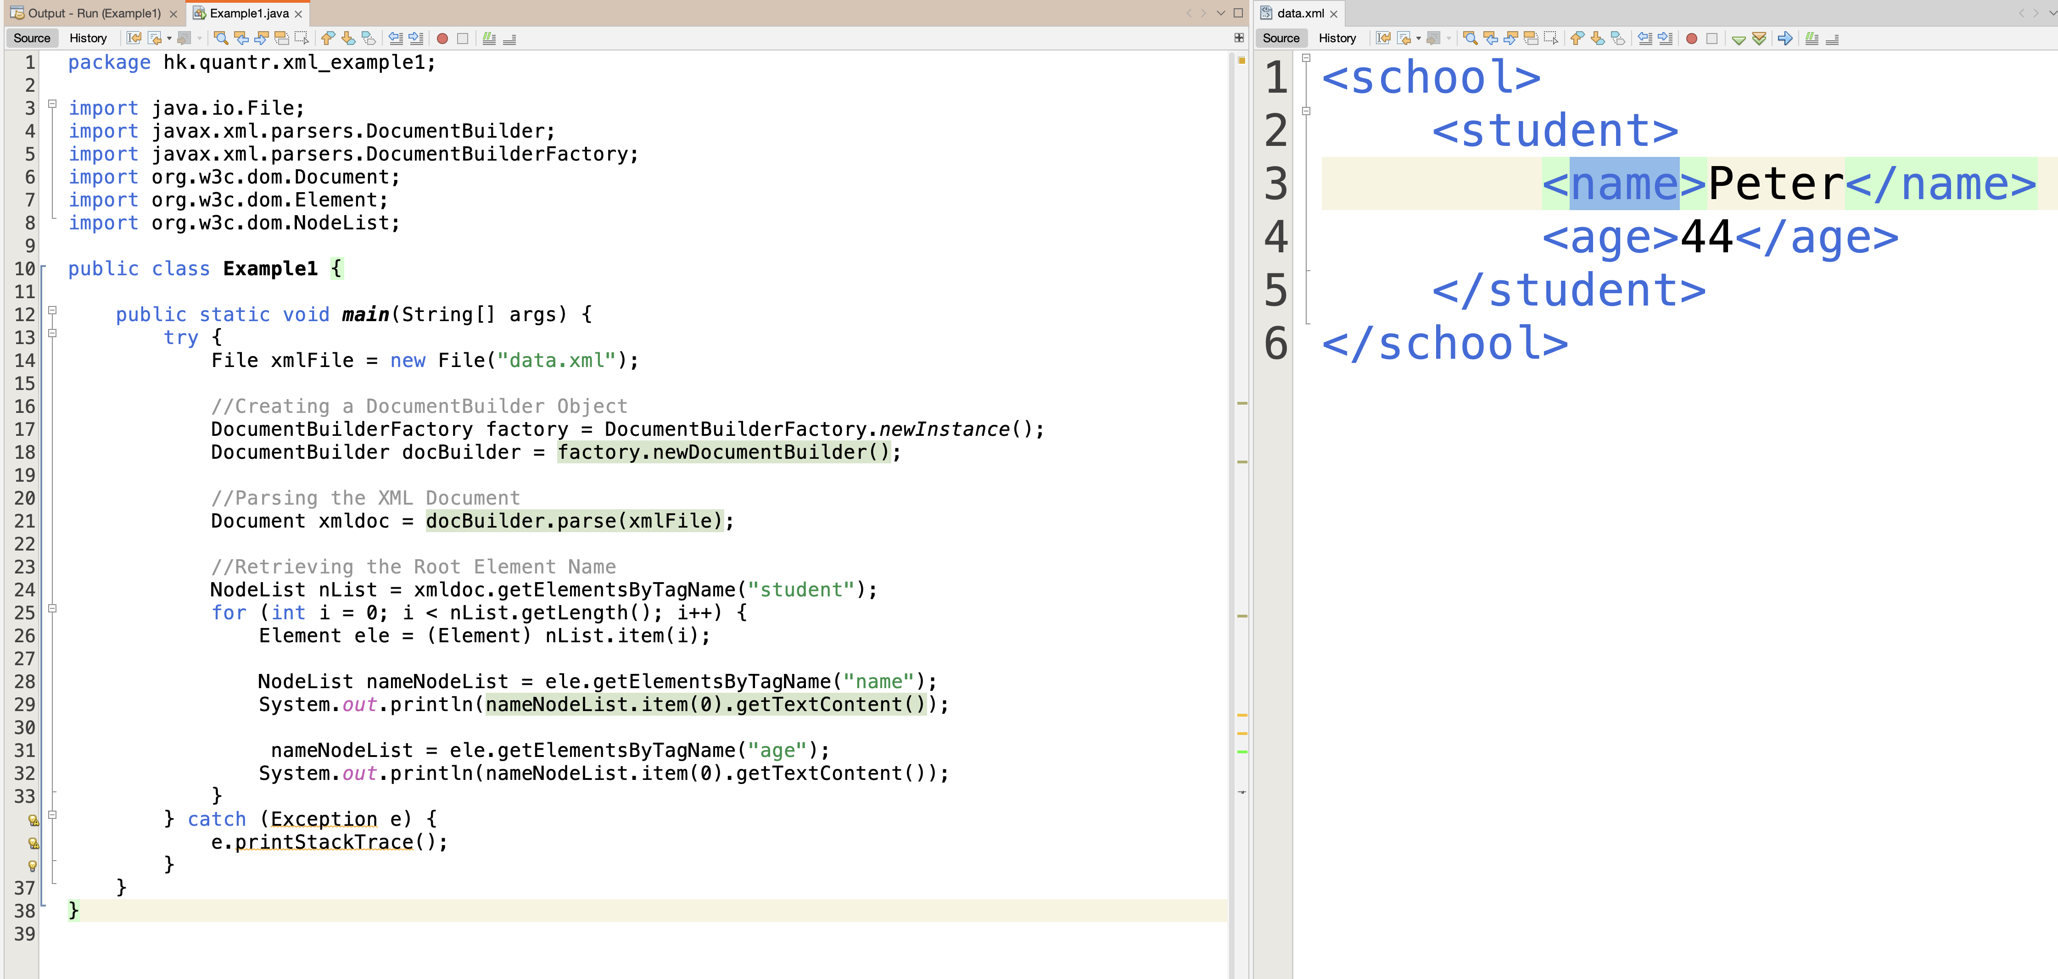

Slide 7
XPath
XPath uses path expressions to select nodes or node-sets in an XML document

Slide 8
Expression | Description
nodename | Selects all nodes with the name "nodename"
/ | Selects from the root node
// | Selects nodes in the document from the current node that match the selection no matter where they are
. | Selects the current node
.. | Selects the parent of the current node
@ | Selects attributes
https://www.javatpoint.com/xpath-tutorial
<bookstore>
<book>
<title lang="en">Harry Potter</title>
<price>29.99</price>
</book>
<book>
<title lang="en">Learning XML</title>
<price>39.95</price>
</book>
</bookstore>
Path Expression | Result
bookstore | Selects all nodes with the name "bookstore"
/bookstore | Selects the root element bookstoreNote: If the path starts with a slash ( / ) it always represents an absolute path to an element!
bookstore/book | Selects all book elements that are children of bookstore
//book | Selects all book elements no matter where they are in the document
bookstore//book | Selects all book elements that are descendant of the bookstore element, no matter where they are under the bookstore element
//@lang | Selects all attributes that are named lang

Slide 9
FileInputStream fileIS = new FileInputStream(new File("data.xml"));
DocumentBuilderFactory builderFactory = DocumentBuilderFactory.newInstance();
DocumentBuilder builder = builderFactory.newDocumentBuilder();
Document xmlDocument = builder.parse(fileIS);
XPath xPath = XPathFactory.newInstance().newXPath();
String expression = "//book/price";
NodeList nodeList = (NodeList) xPath.compile(expression).evaluate(xmlDocument, XPathConstants.NODESET);
for (int x = 0; x < nodeList.getLength(); x++) {
System.out.println(nodeList.item(x).getTextContent());
}

Slide 10
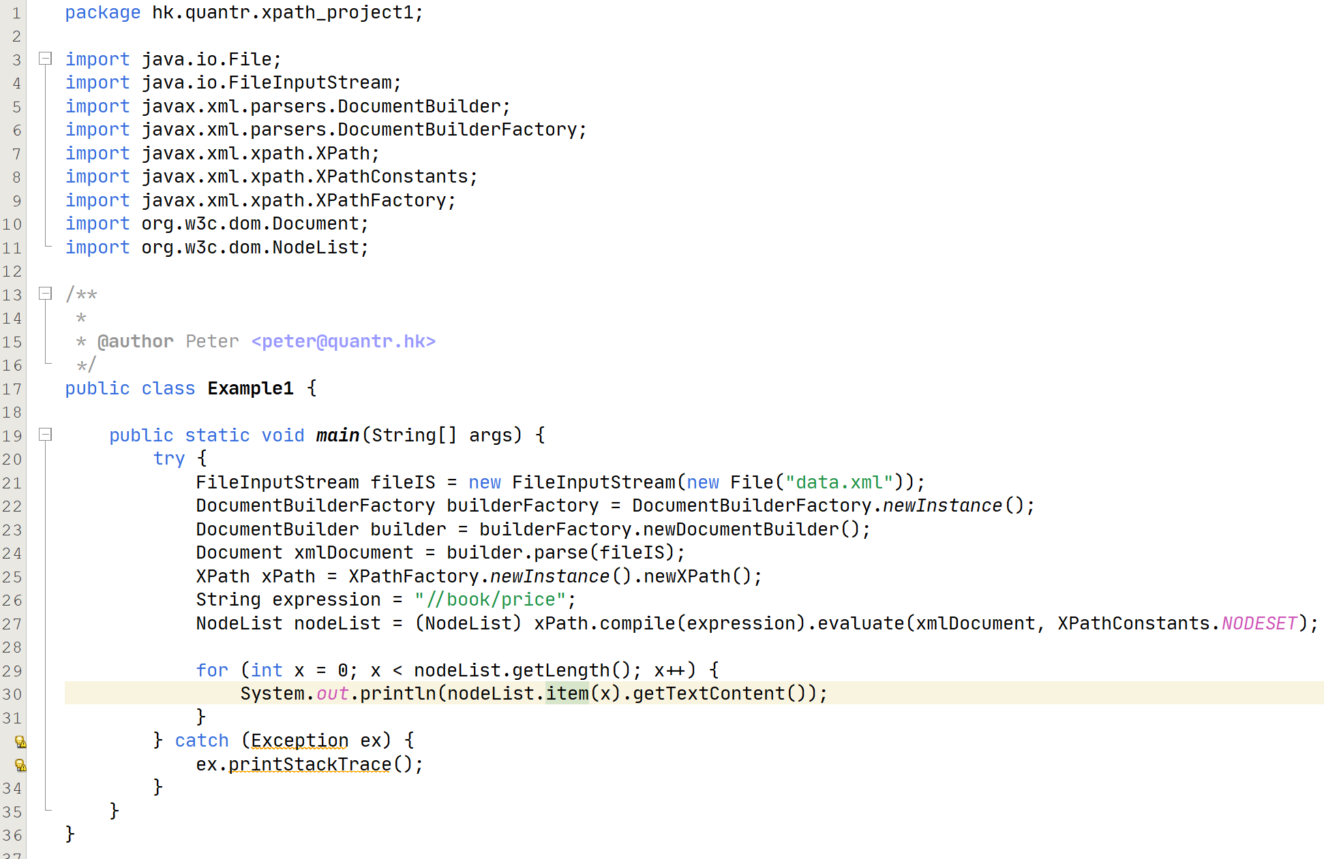

Slide 11
Path Expression | Result
/bookstore/book[1] | Selects the first book element that is the child of the bookstore element. Note: In IE 5,6,7,8,9 first node is[0], but according to W3C, it is [1]. To solve this problem in IE, set the selectionlanguage to XPath:in JavaScript: xml.setProperty("SelectionLanguage","XPath");
/bookstore/book[last()] | Selects the last book element that is the child of the bookstore element.
/bookstore/book[last()-1] | Selects the last but one book element that is the child of the bookstore element.
/bookstore/book[position()<3] | Selects the first two book elements that are children of the bookstore element.
//title[@lang] | Selects all the title elements that have an attribute named lang.
//title[@lang='en'] | Selects all the title elements that have a "lang" attribute with a value of "en".
/bookstore/book[price>100] | Selects all the book elements of the bookstore element that have a price element with a value greater than 100
/bookstore/book[price>100]/title | Selects all the title elements of the book elements of the bookstore element that have a price element with a value greater than 100

Slide 12
Path Expression | Result
/bookstore/* | Selects all the child element nodes of the bookstore element
//* | Selects all elements in the document
//title[@*] | Selects all title elements which have at least one attribute of any kind
Path Expression | Result
//book/title | //book/price | Selects all the title and price elements of all book elements
//title | //price | Selects all the title and price elements in the document
/bookstore/book/title | //price | Selects all the title elements of the book element of the bookstore element and all the price elements in the document

Slide 13
Use 3rd Party Library
Apache Maven

Slide 14

https://x-stream.github.io/

Slide 15
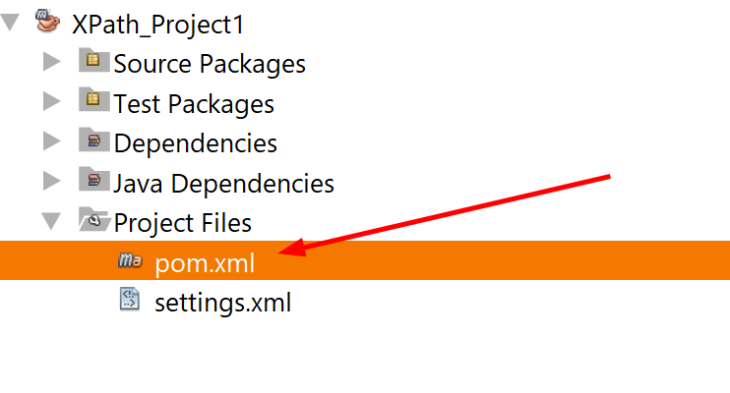
pom.xml ← Project file

Slide 16
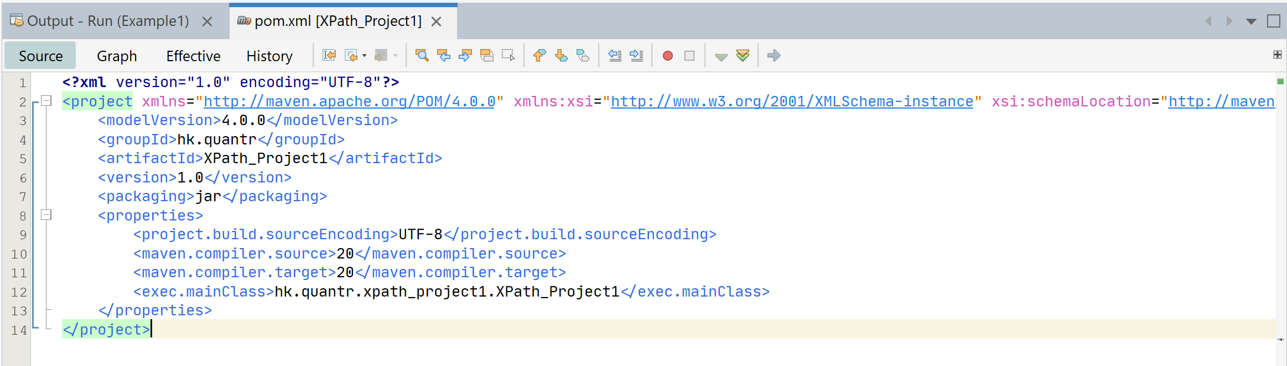
pom.xml

Slide 17
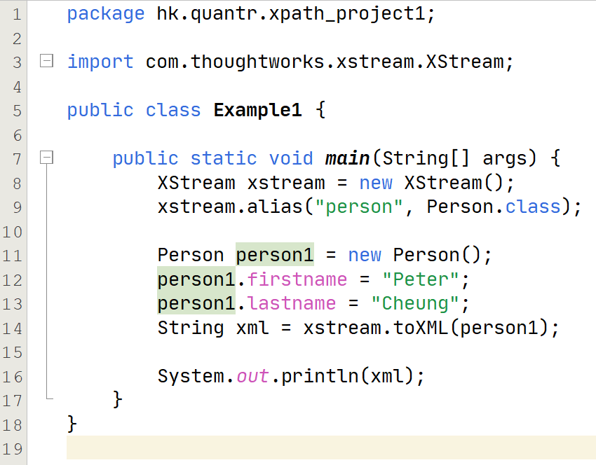
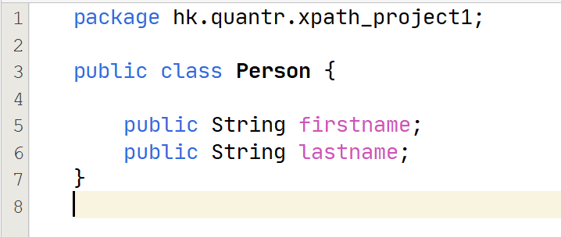
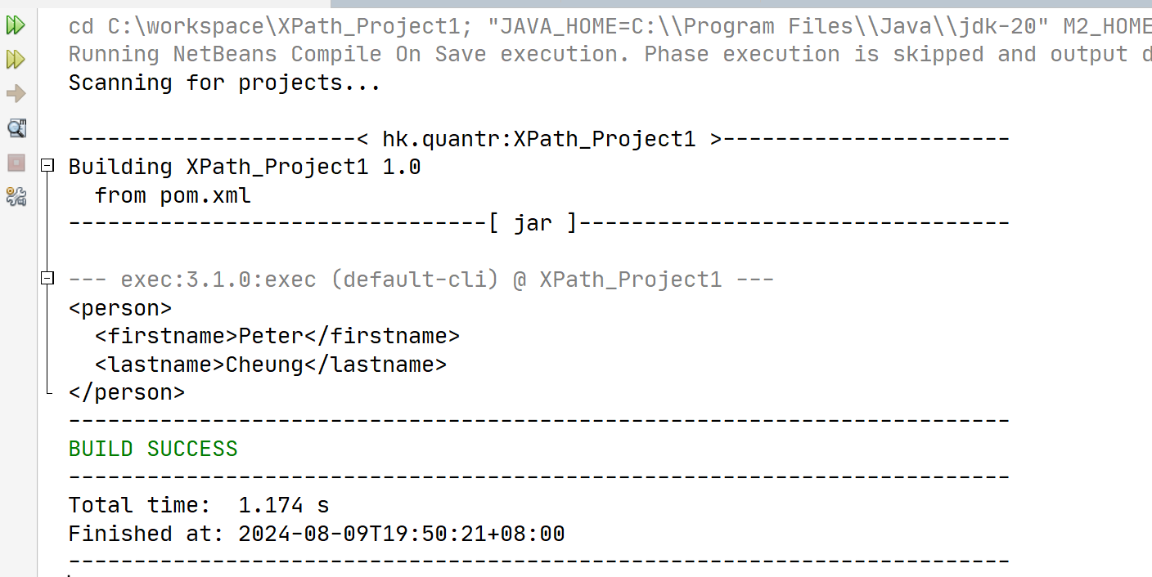
Example 1

Slide 18
Apache Commons
An open source Java Library
https://commons.apache.org/proper/commons-io/description.html

Slide 19
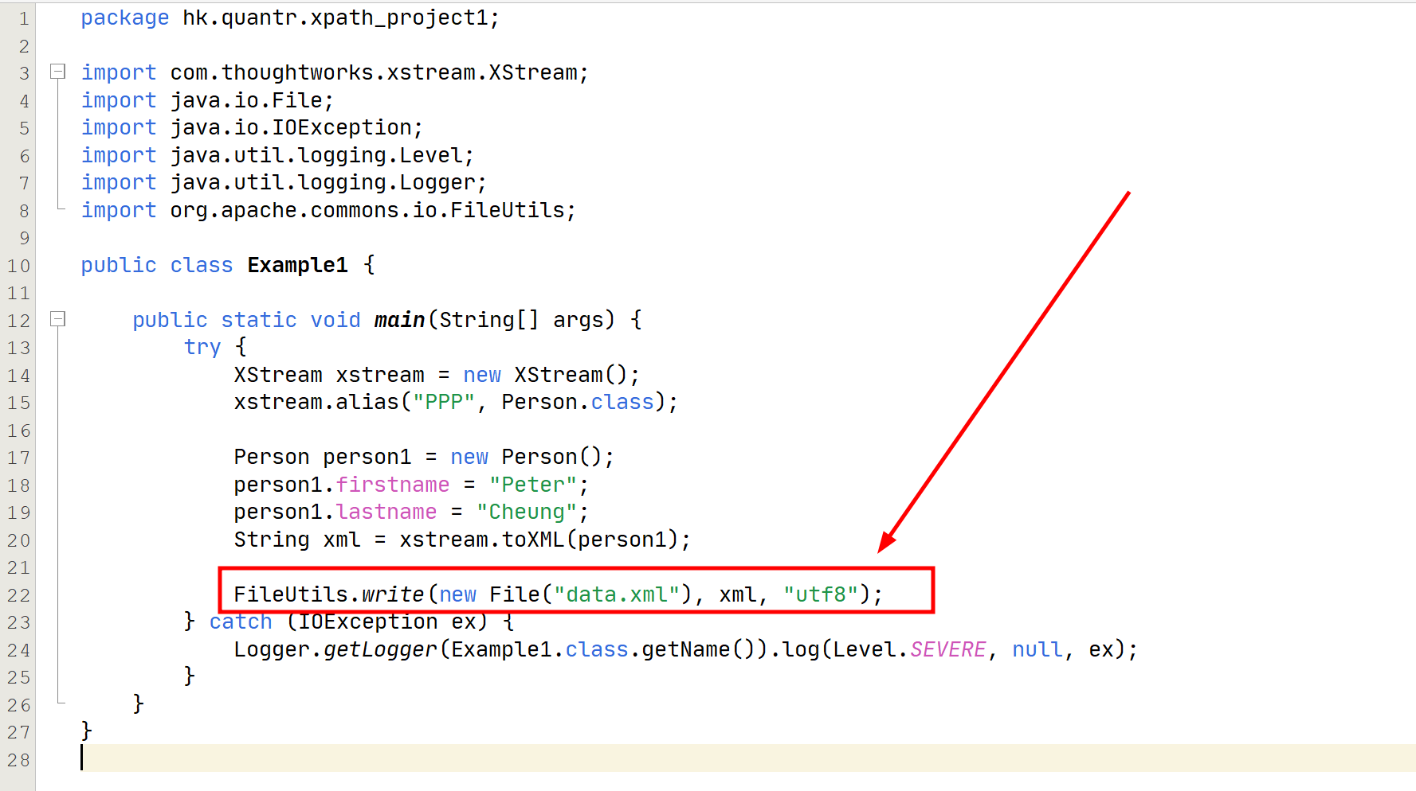

Slide 20
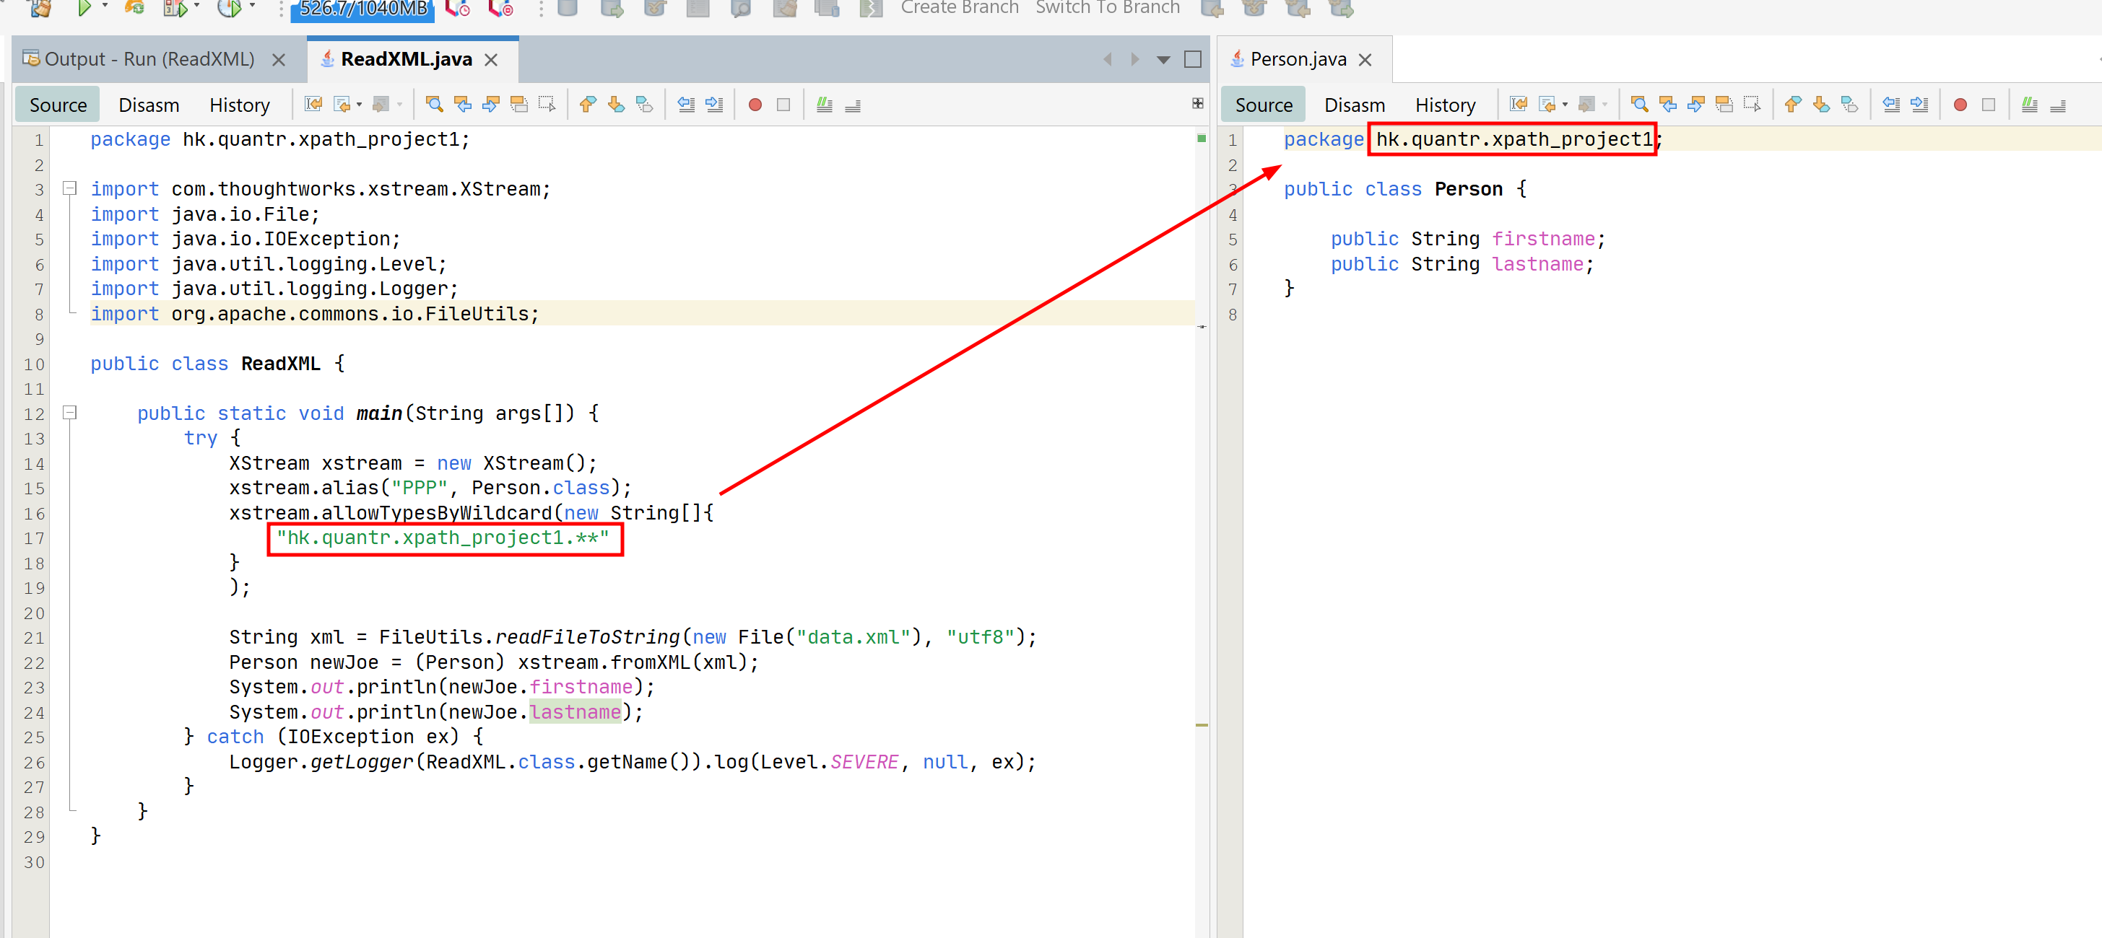
Serializing an object to XML

Slide 21
功課
Object
xml file
Serialize
xml file
Object
De-serialize

Slide 22
Thank you
香港編程學會
Peter
96554595

