Slide 1


Java第14堂
香港編程學會
Peter

Slide 2
Agenda
Jar
Executable Jar
Maven Repo
Create Library
香港編程學會

Slide 3
功課一
Project 3
Project 1
Call function

Slide 4
功課二 – submit to hkprog.org
Project 1
Submit
Maven Central
Project 1
Submit
https://www.hkprog.org/maven/
Get
Project 2

Slide 5
功課三 – executable jar
<build>
<plugins>
<plugin>
<artifactId>maven-compiler-plugin</artifactId>
<version>3.10.1</version>
</plugin>
<plugin>
<groupId>org.apache.maven.plugins</groupId>
<artifactId>maven-assembly-plugin</artifactId>
<version>3.4.2</version>
<executions>
<execution>
<id>package-jar-with-dependencies</id>
<phase>package</phase>
<goals>
<goal>single</goal>
</goals>
<configuration>
<descriptorRefs>
<descriptorRef>jar-with-dependencies</descriptorRef>
</descriptorRefs>
<archive>
<manifest>
<mainClass>org.hkps.project3.NewJFrame</mainClass>
</manifest>
</archive>
</configuration>
</execution>
</executions>
</plugin>
</plugins>
<resources>
<resource>
<directory>src/main/resources</directory>
<filtering>true</filtering>
</resource>
</resources>
</build>

Slide 6
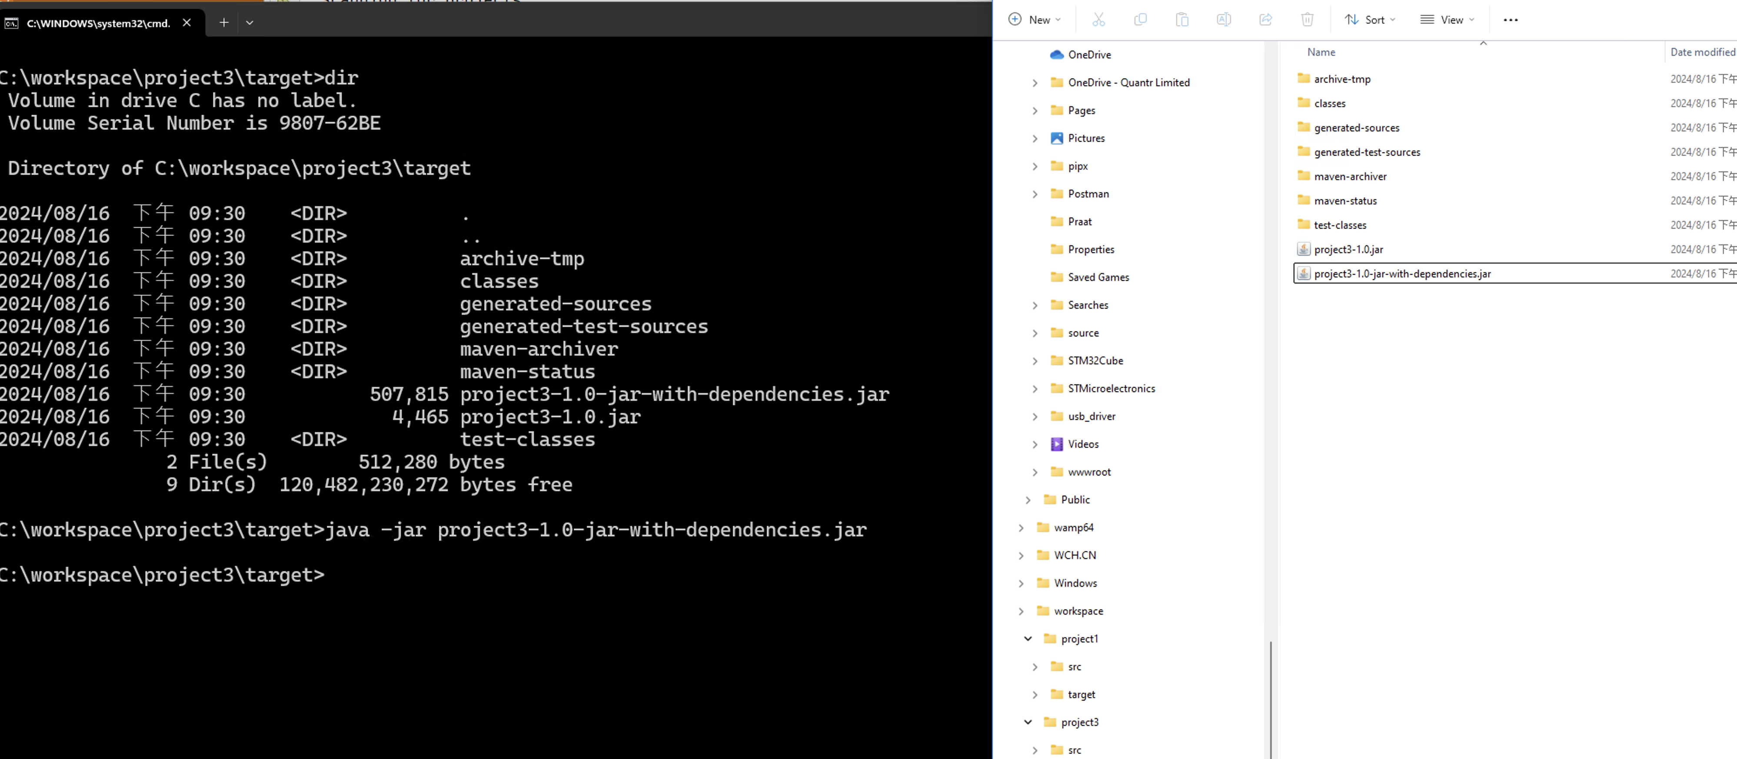
功課三 – executable jar
打command : java –jar xxxx-dependenies.jar
double click jar

Slide 7
Thank you
香港編程學會
Peter
96554595

