Slide 1


香港編程學會實體堂1
2024 Aug 23
Peter

Slide 2

熱烈感謝
生產力局
Git
Java
JTable

Slide 3

The power of Education

Slide 4

編程學會教育理念
點教編程先教得好

Slide 5
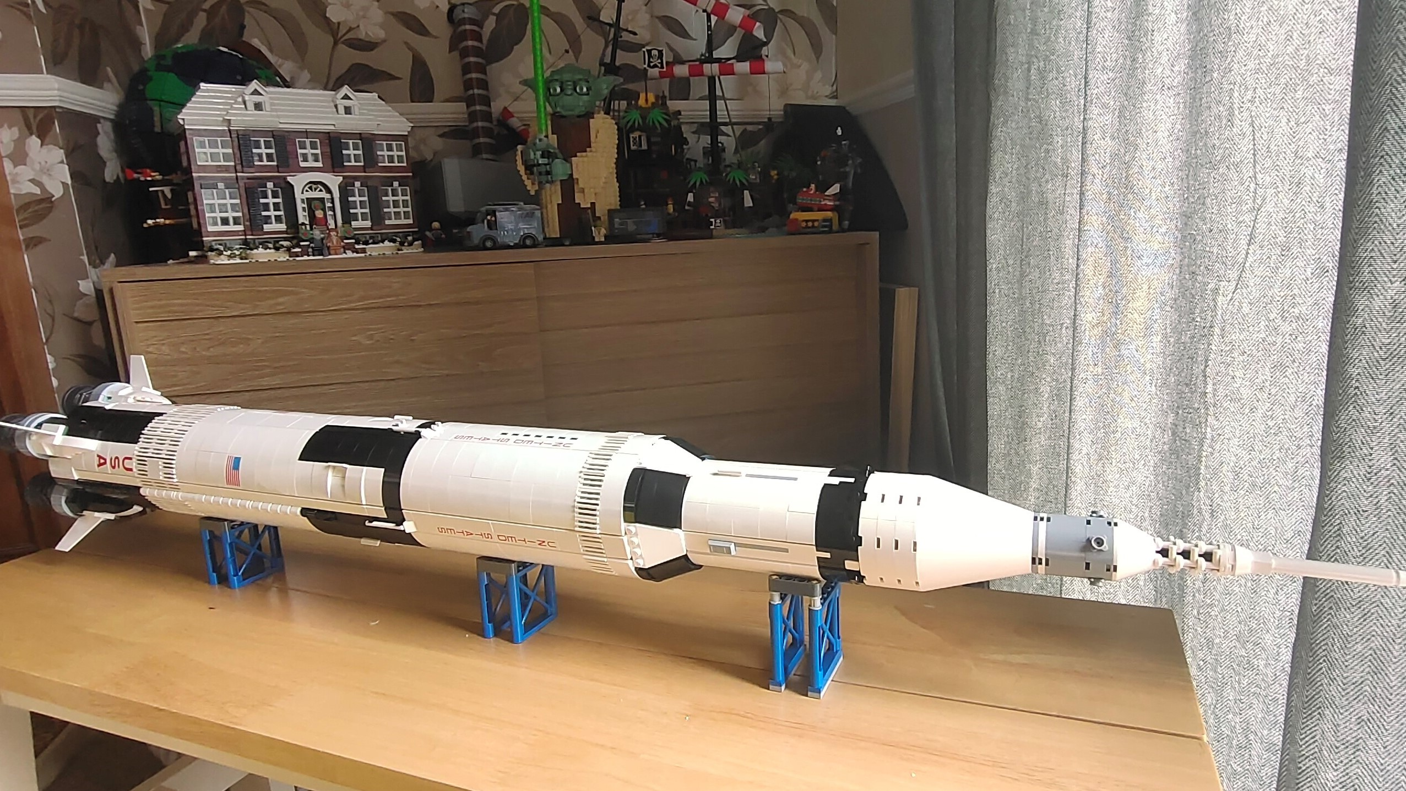

教育手法

Slide 6
Typescript
JS
Script
教育章法
Java
Python
C++
C
ASM

Slide 7
教育傳達技巧
Learn By Doing
Learn By Teaching

Slide 8
Learn By Doing
Learn By Teaching

Slide 9

Let the Kids work together

Slide 10
GIT

Slide 11
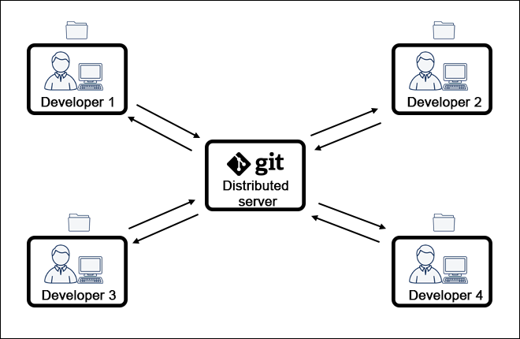

Slide 12
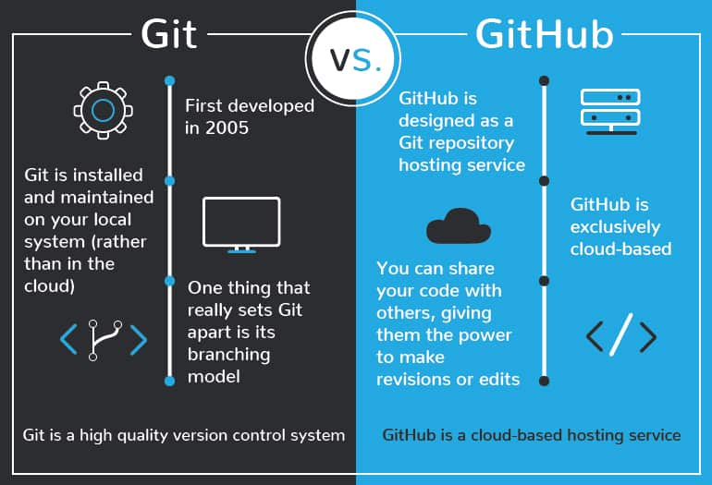

Slide 13
Working Folder
Local Repo
Git hub repo

Slide 14
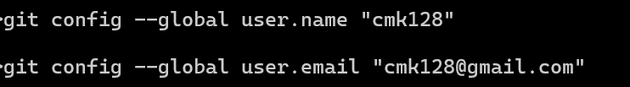

Slide 15
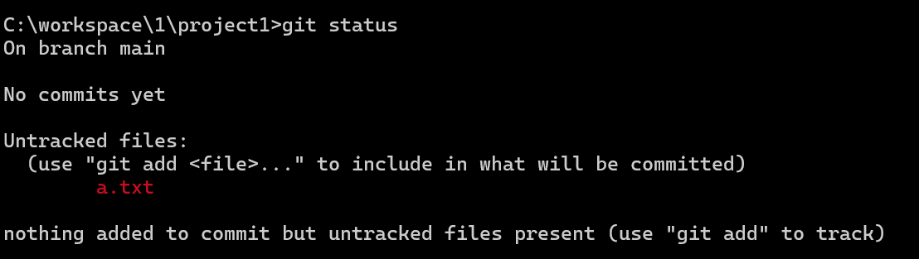
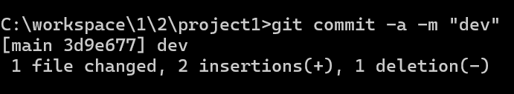
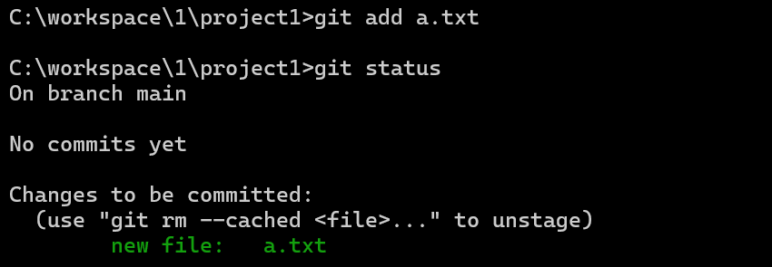
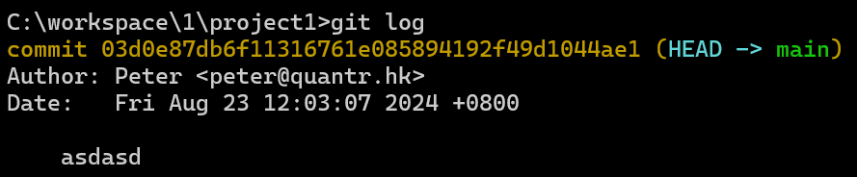
git status
git add
git commit
Working Folder
Local Repo
Git hub repo
git log

Slide 16
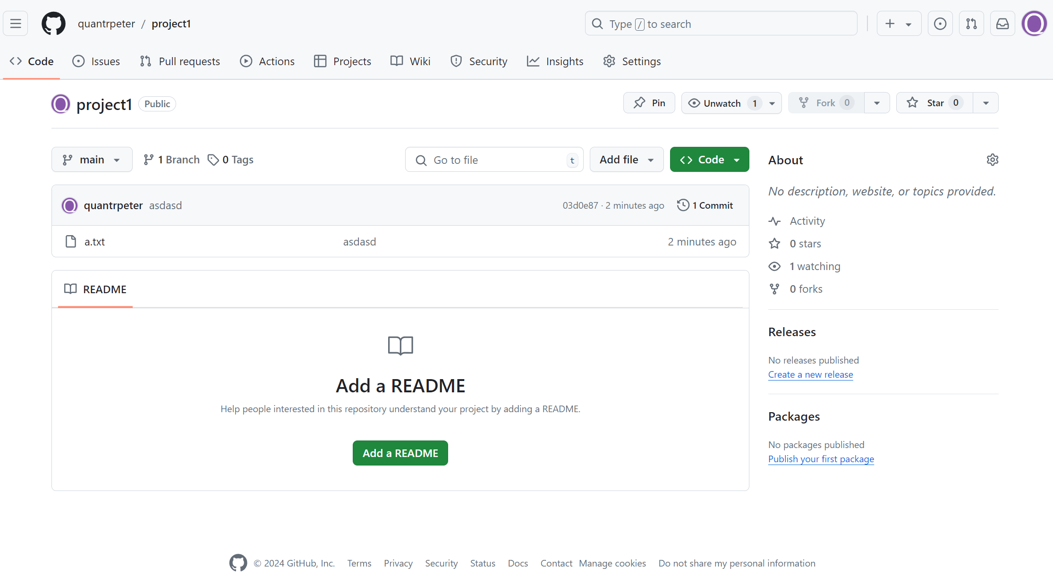
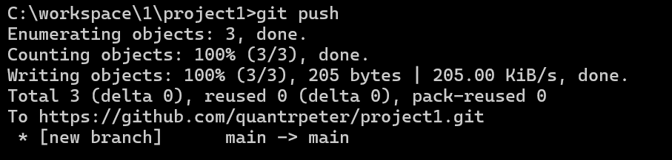
Working Folder
Local Repo
Git hub repo
git push
commit 1
commit 2
commit 3

Slide 17
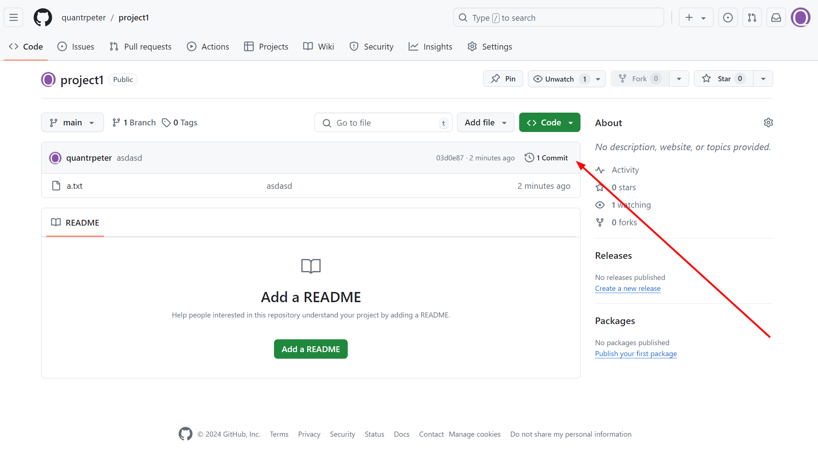
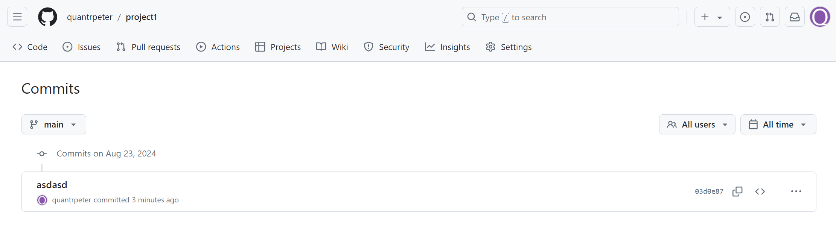

Slide 18
How people work together
Work on same project
Fork the project, and merge back

Slide 19
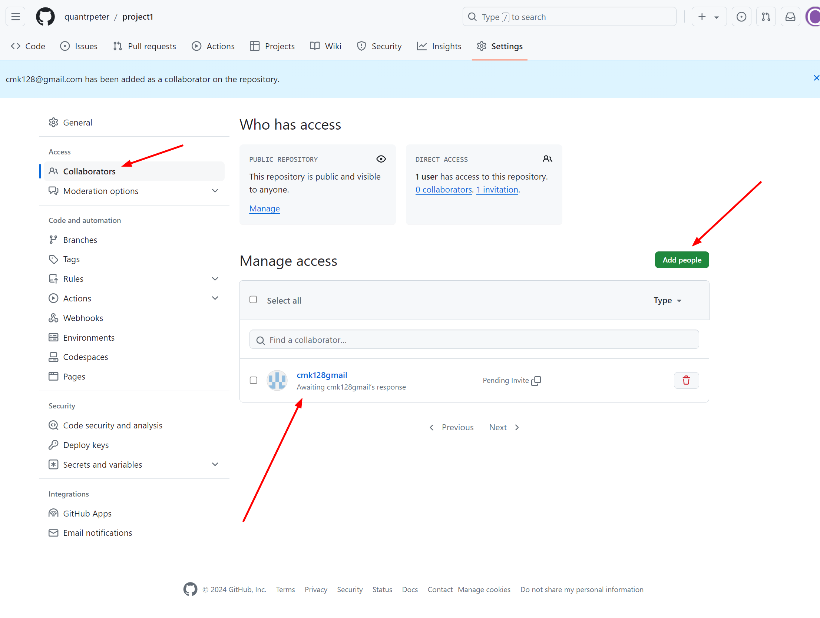

Slide 20
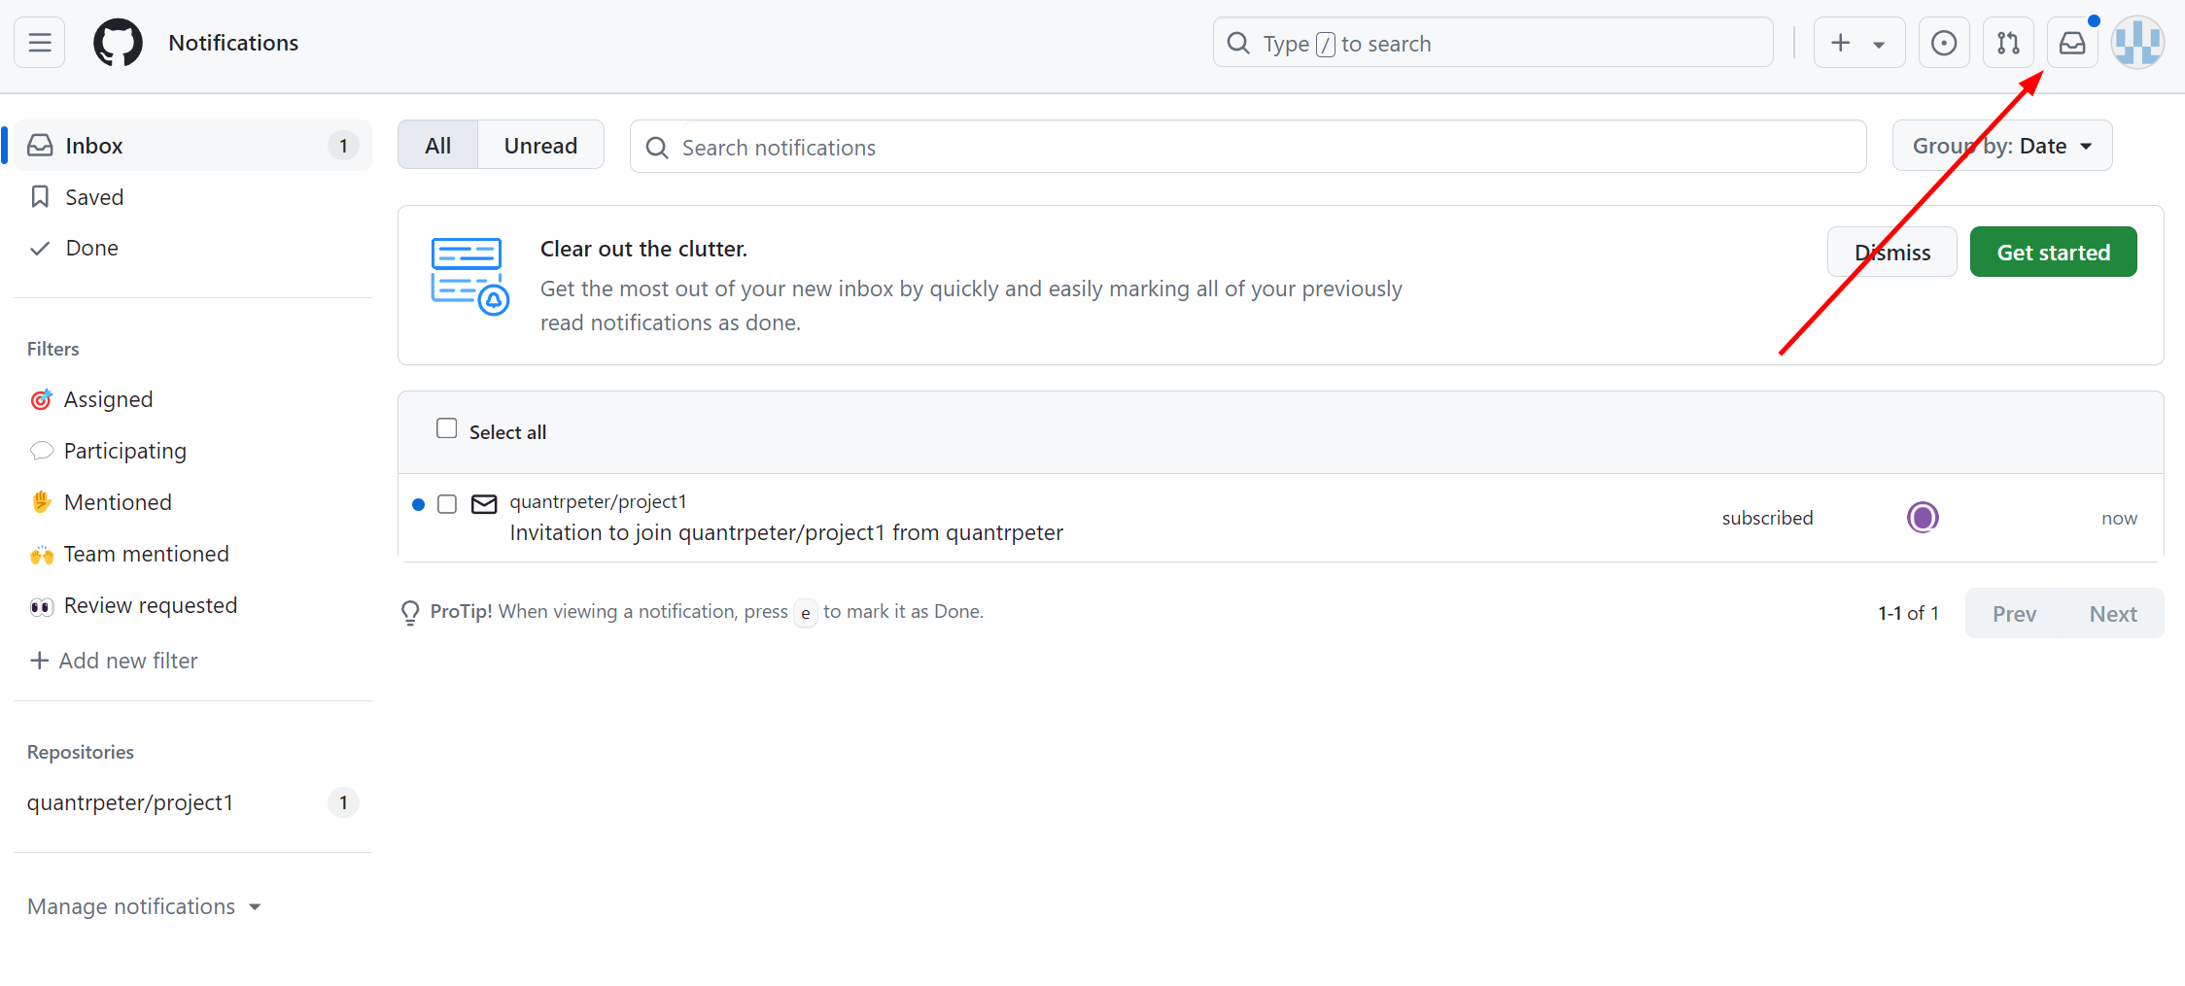

Slide 21
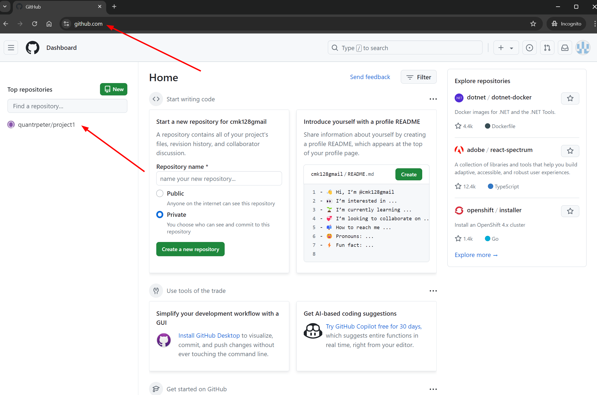

Slide 22
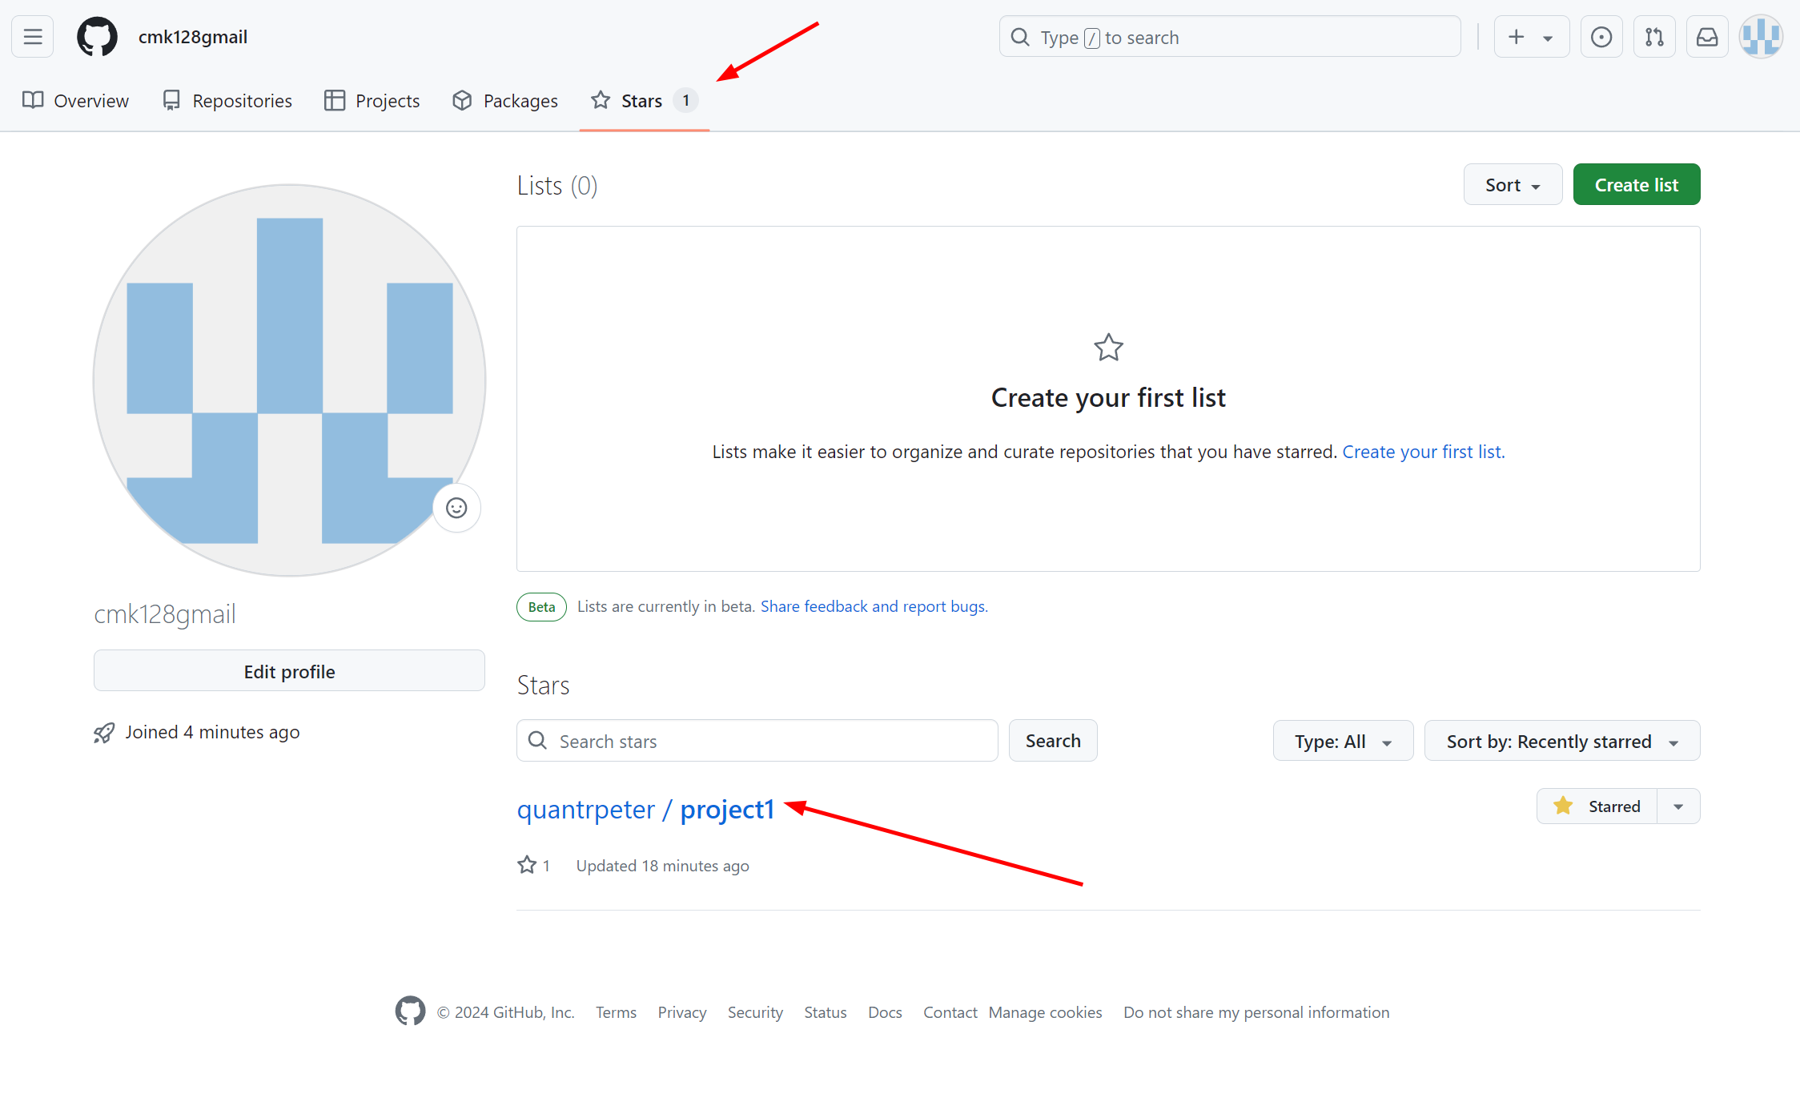

Slide 23
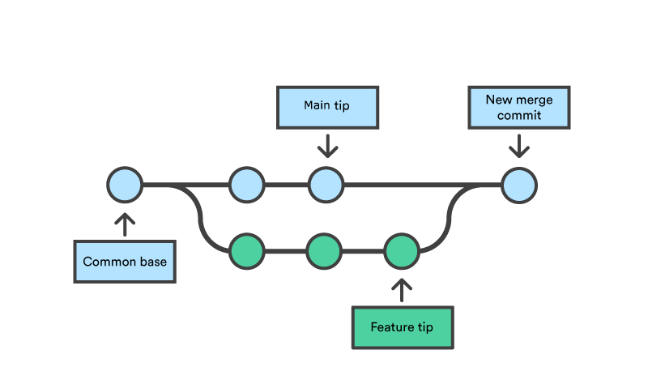
Work on same project - Merge

Slide 24
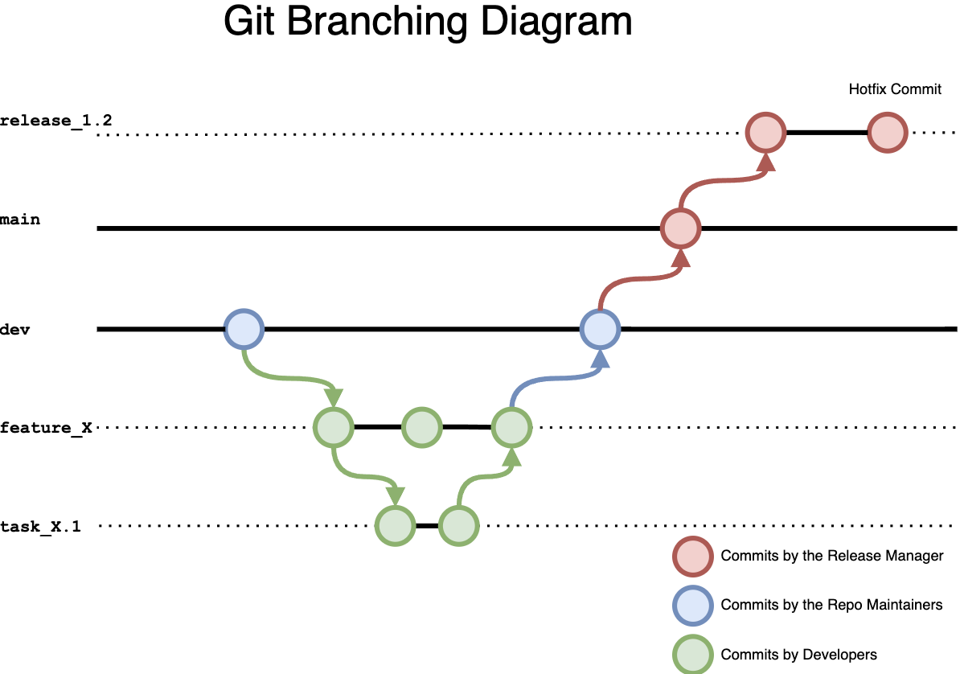
Branch

Slide 25


Slide 26
Thank you
Peter
9655-4595
peter@hkprog.org

