Slide 1


Antlr Lesson 1
香港編程學會
Peter

Slide 2
Agenda
  What is ANTLR
  LL Grammars
香港編程學會

Slide 3
What is ANTLR
ANTLR (pronounced Antler), or Another Tool For Language Recognition, is a parser generator that uses LL(*) for parsing.
ANTLR takes as input a grammar that specifies a language and generates as output source code for a recognizer for that language.
  supported generating code in Java, C#, JavaScript, Python2 and Python3.

Slide 4
LL(K) Grammars
An LL parser is a top-down parser for a subset of context-free languages.
  It parses the input from Left to right, performing Leftmost derivation of the sentence.
An LL parser is called an LL(k) parser if it uses k tokens of look-ahead when parsing a sentence.
The LL(K) parser is a deterministic pushdown automaton with the ability to peek on the next k input symbols without reading.

Slide 5

History
Initial release:
  February 1992; 24 years ago.
Stable release:
  4.5.1 / July 15, 2015; 14 months ago
Its maintainer is:
  Professor Terence Parr
  University of San Francisco.

Slide 6
ANTLR Components: How it Works?
ANTLR Grammar
(*.g4)
Java Compiler
Input Text
(.txt)
ANTLR Tool
*.java & *.token
Generated Code
*.class
Our
Compiler
The Result
ANTLR runtime (parse-time)
API
ANTLR jar file

Slide 7
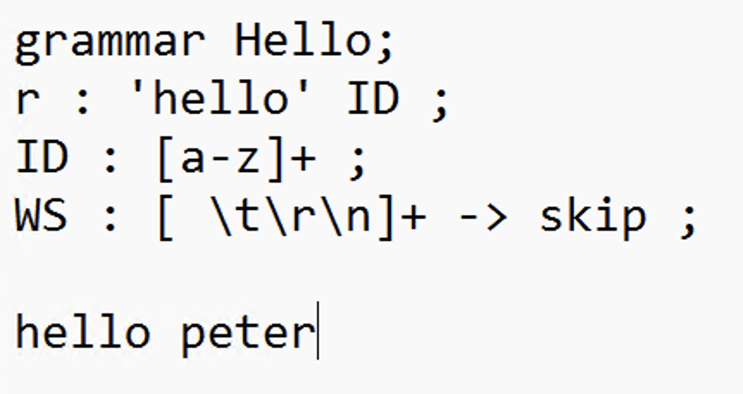
功課
Install Antlr (watch video)
Create “antlr4.bat”
  java -cp C:\Users\Peter\Downloads\antlr-4.13.2-complete.jar;%CLASSPATH% org.antlr.v4.Tool %*
Create grammar file (Hello.g4)
Compile
  java -cp C:\Users\Peter\Downloads\antlr-4.13.2-complete.jar; org.antlr.v4.Tool Hello.g4
  javac -cp C:\Users\Peter\Downloads\antlr-4.13.2-complete.jar *.java
  java -cp C:\Users\Peter\Downloads\antlr-4.13.2-complete.jar; org.antlr.v4.runtime.misc.TestRig Hello r -tokens\
  Ctrl-Z

Slide 8
Thank you
香港編程學會
Peter
96554595

