Slide 1


Java第15堂
香港編程學會
Peter

Slide 2
Agenda
  Static vs non static
  Design Pattern
  Singleton
香港編程學會

Slide 3
Static
Static = 無狀態
狀態姐係Object嘅狀態

Slide 4
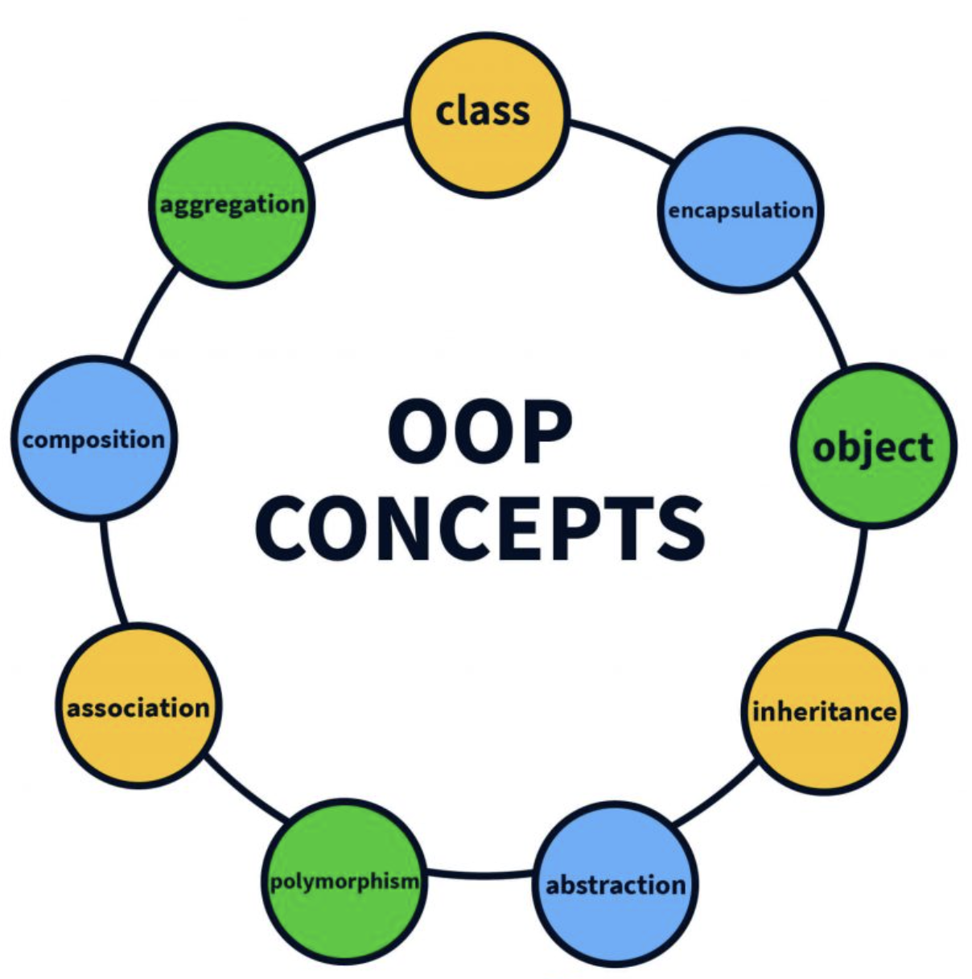
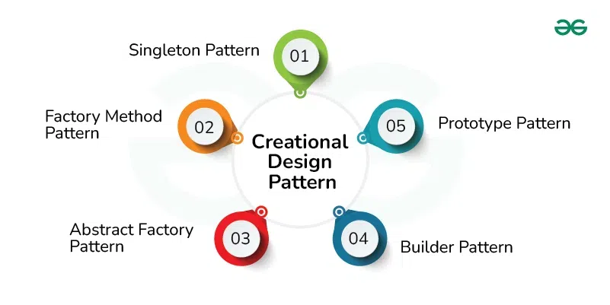
Design Pattern設計模式
In software engineering, a design pattern describes a relatively small, well-defined aspect (i.e. functionality) of a computer program in terms of how to write the code.

Slide 5
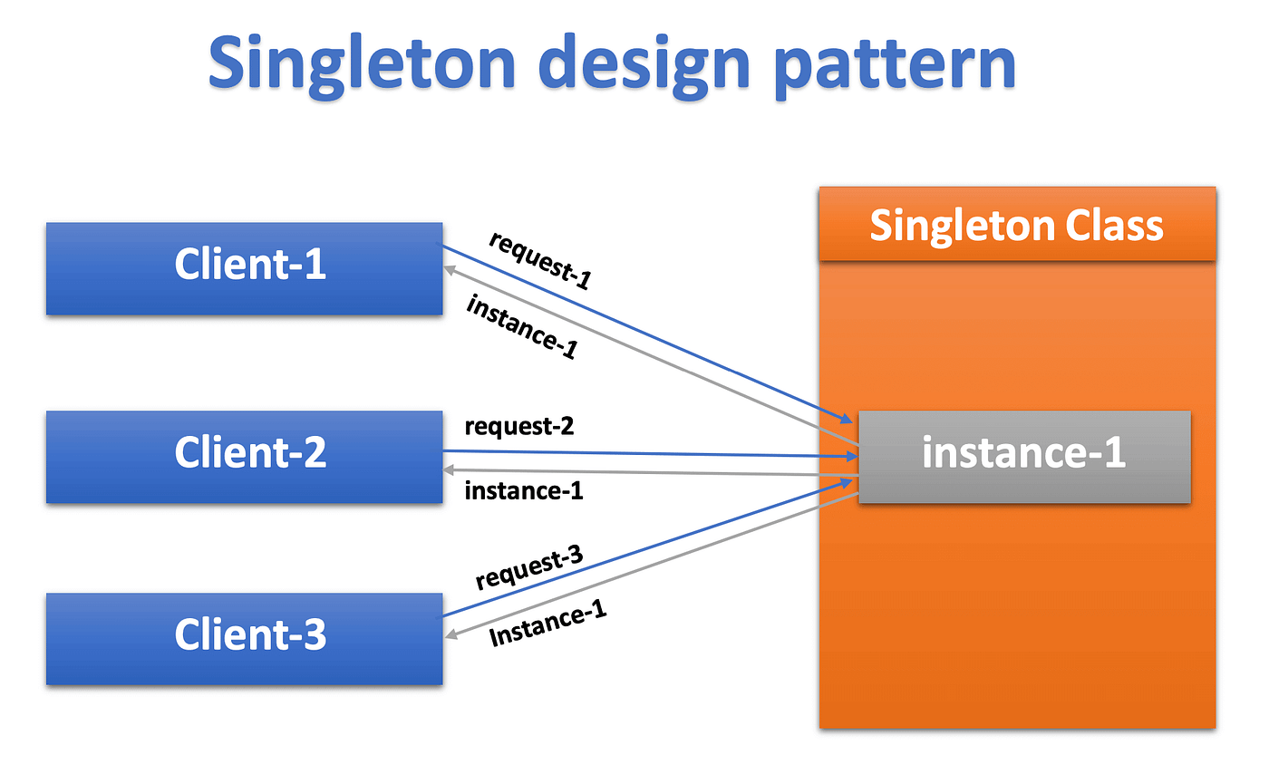
Singleton Pattern
Ensure a class has only one instance, and provide a global point of access to it.

Slide 6
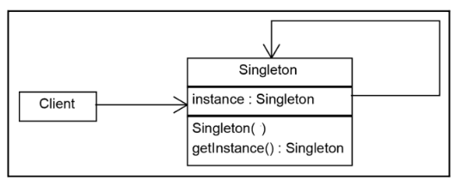
Singleton Pattern
public class Singleton {
private static volatile Singleton instance = null;
private Singleton() {}
public static Singleton getInstance() {
if (instance == null) {
synchronized(Singleton.class) {
if (instance == null) {
instance = new Singleton();
}
}
}
return instance;
}
}

Slide 7
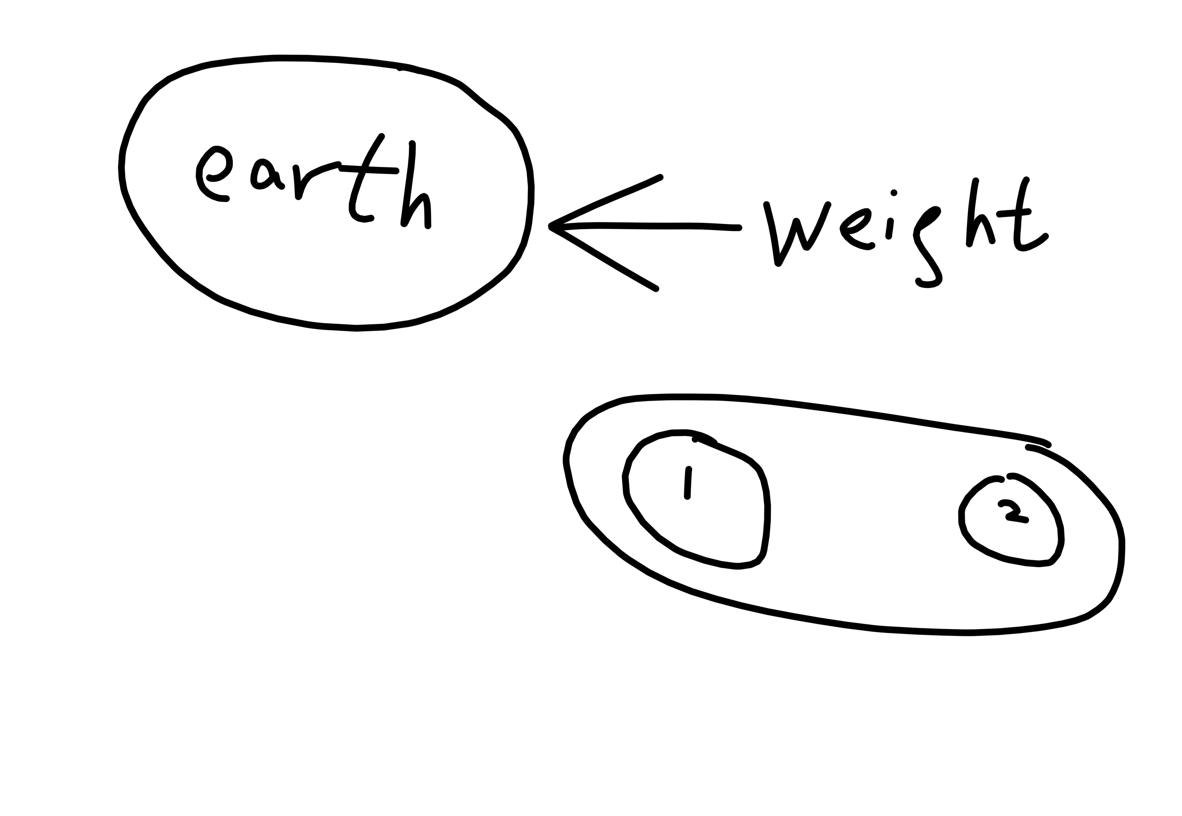

Slide 8
Thank you
香港編程學會
Peter
96554595

