Slide 1


Java第16堂
香港編程學會
Peter

Slide 2
Agenda
  Design Pattern : Abstract Factory
  ExecutorService
香港編程學會

Slide 3
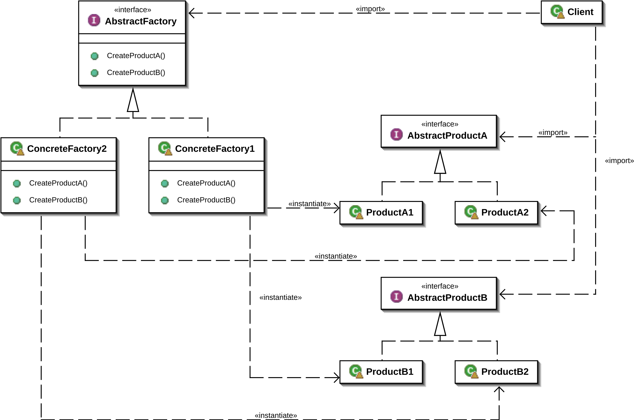
https://gitlab.com/peter-example/java/design-pattern/abstract-factory-pattern
The abstract factory pattern in software engineering is a design pattern that provides a way to create families of related objects

Slide 4
ExecutorService
ExecutorService is a JDK API that simplifies running tasks in asynchronous mode
無序創建線程(Thread)，有序運行

Slide 5
Thank you
香港編程學會
Peter
96554595

