Slide 1

LeetCode訓練營
第一堂
香港編程學會
LinkedList + Queue + Stack + Binary Search

Slide 2
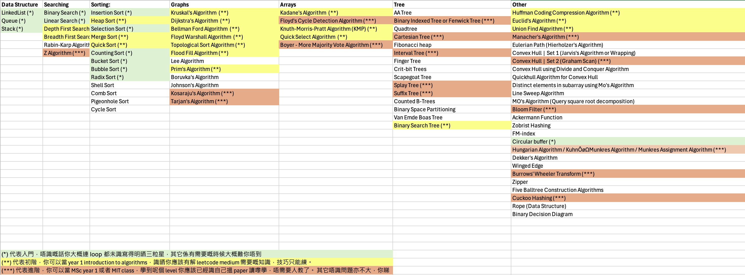

Slide 3
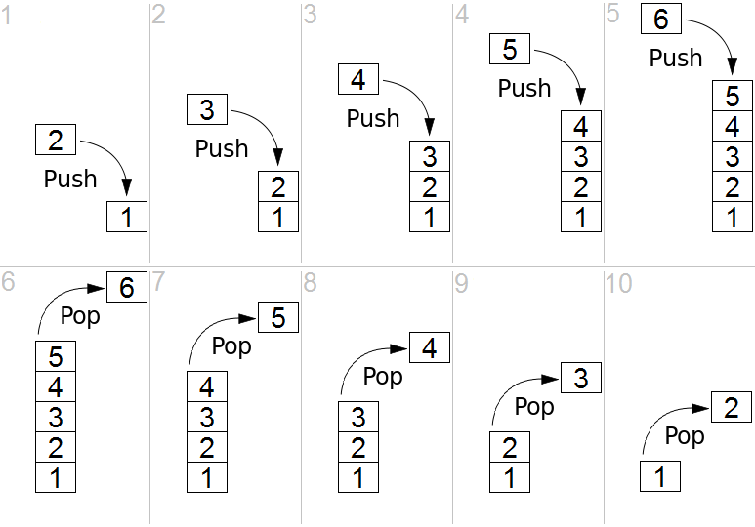
Stack

Slide 4
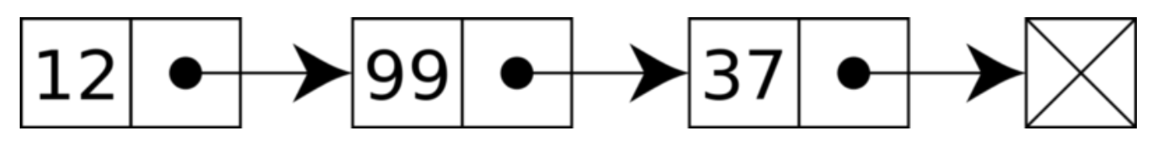
LinkedList
Single LinkedList
Double LinkedList

Slide 5
Implement LinkedList In Java

Slide 6
功課一 : Implement double linkedlist

Slide 7
Binary Search
Binary Search Algorithm is a searching algorithm used in a sorted array by repeatedly dividing the search interval in half.

Slide 8
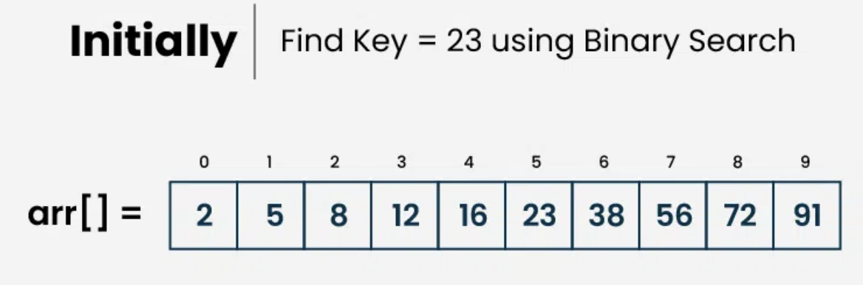

Slide 9
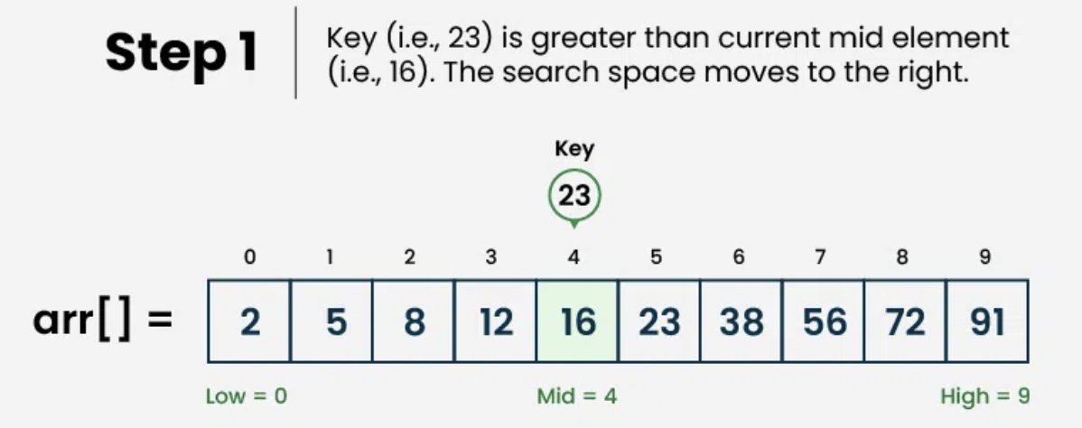

Slide 10
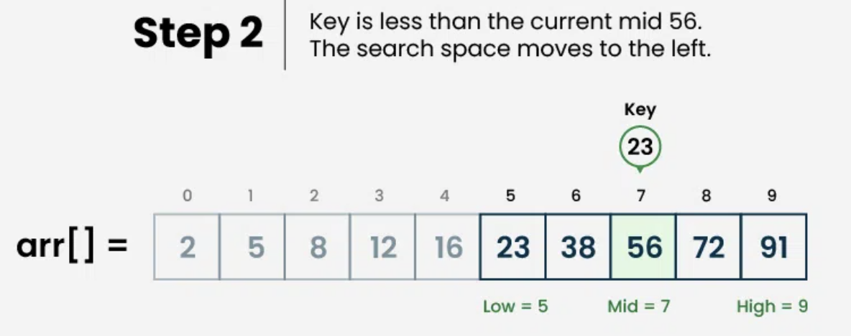

Slide 11
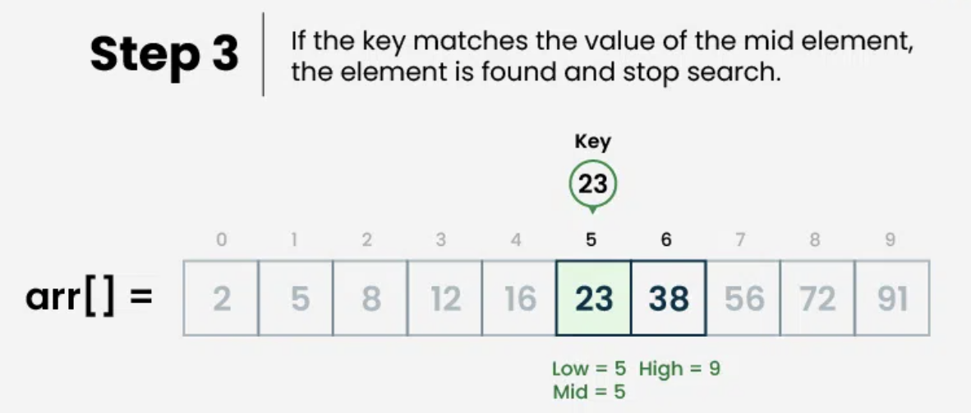

Slide 12
Code
int binarySearch(int arr[], int x) {
int low = 0, high = arr.length - 1;
while (low <= high) {
int mid = low + (high - low) / 2; // Check if x is present at mid
if (arr[mid] == x) return mid; // If x greater, ignore left half
if (arr[mid] < x)
low = mid + 1; // If x is smaller, ignore right half
else
high = mid - 1;
}
// If we reach here, then element was not present
return -1;
}

Slide 13
功課二 : Make it work

Slide 14

Thank You

