Slide 1


Java第21堂
香港編程學會
Peter

Slide 2
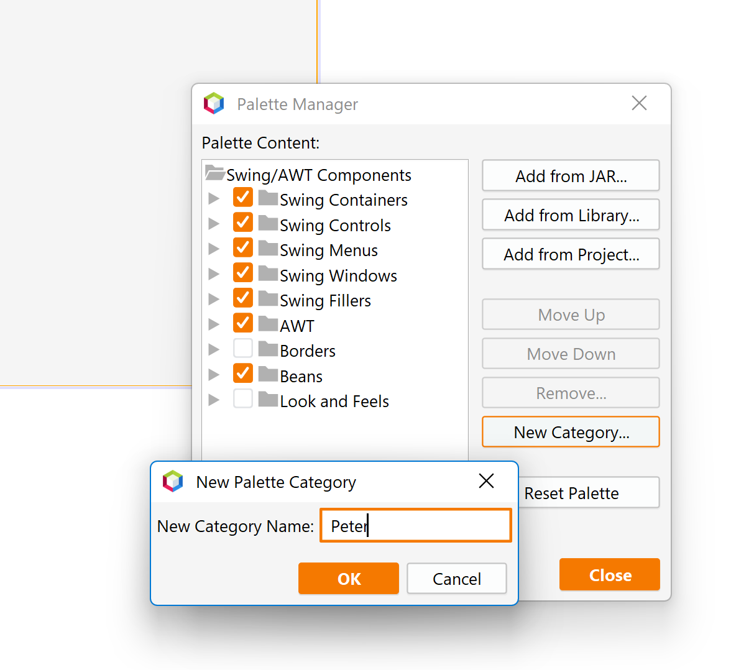

在Netbeans創造Palette

Slide 3
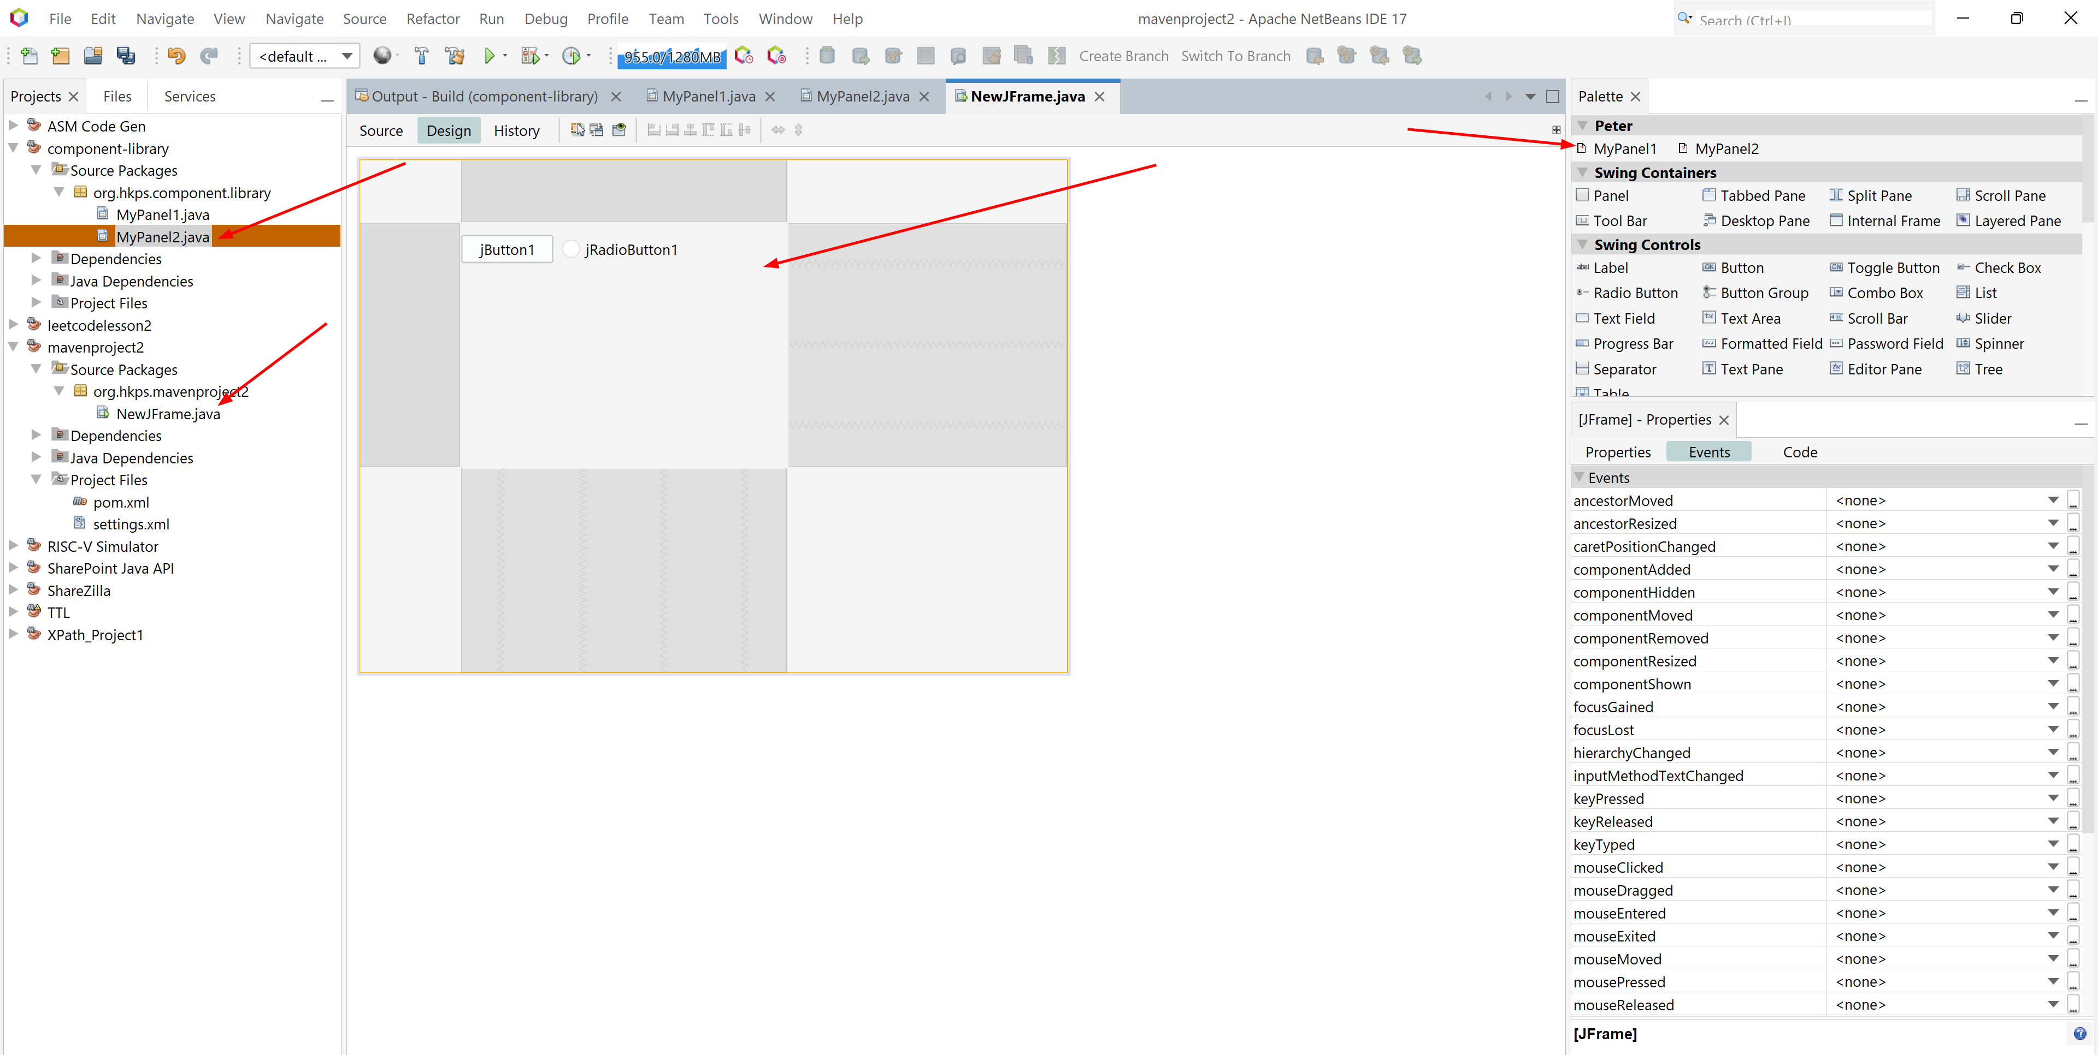

Slide 4
功課1
自己試一次在Netbeant創造palette

Slide 5
Storage
Write
Program
XML
Read

Slide 6
Storage
package org.hkps.mavenproject2;
import java.io.File;
import java.io.FileInputStream;
import java.io.FileOutputStream;
import com.thoughtworks.xstream.XStream;
import java.io.FileNotFoundException;
import java.io.IOException;
import org.apache.commons.io.IOUtils;
public class Setting {
private static Setting setting = null;
public static File file = new File("setting.xml");
public int x;
public int y;
public int width;
public int height;
private Setting() {
width = 1600;
height = 1000;
}
public static Setting getInstance() {
if (setting == null) {
setting = load();
}
return setting;
}
public void save() {
XStream xstream = new XStream();
xstream.alias("Setting", Setting.class);
String xml = xstream.toXML(this);
try {
IOUtils.write(xml, new FileOutputStream(file), "utf8");
} catch (IOException e) {
e.printStackTrace();
}
}
public static Setting load() {
try {
XStream xstream = new XStream();
xstream.allowTypes(new Class[]{Setting.class});
xstream.alias("Setting", Setting.class);
Setting s = (Setting) xstream.fromXML(new FileInputStream(file));
return s;
} catch (FileNotFoundException ex) {
ex.printStackTrace();
file.delete();
setting = new Setting();
setting.save();
return setting;
}
}
}

Slide 7
功課2
Setting支援width + height

Slide 8
Encryption

Slide 9


Slide 10
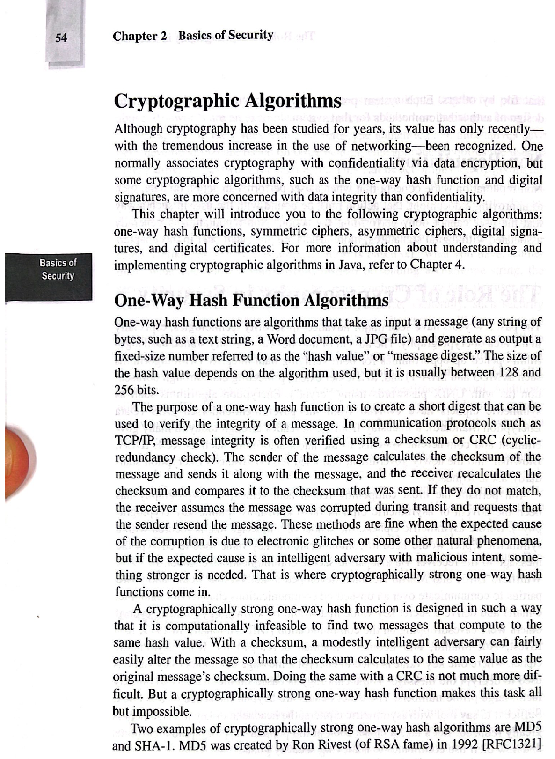

Slide 11
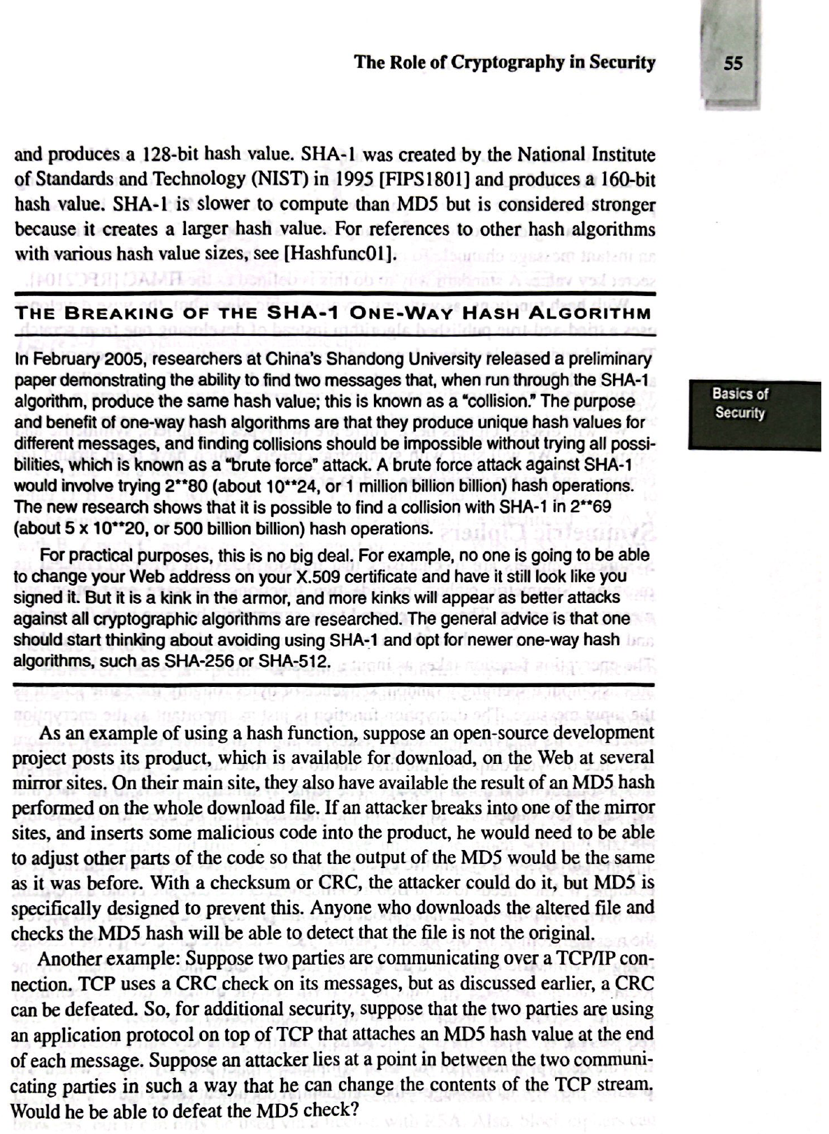

Slide 12
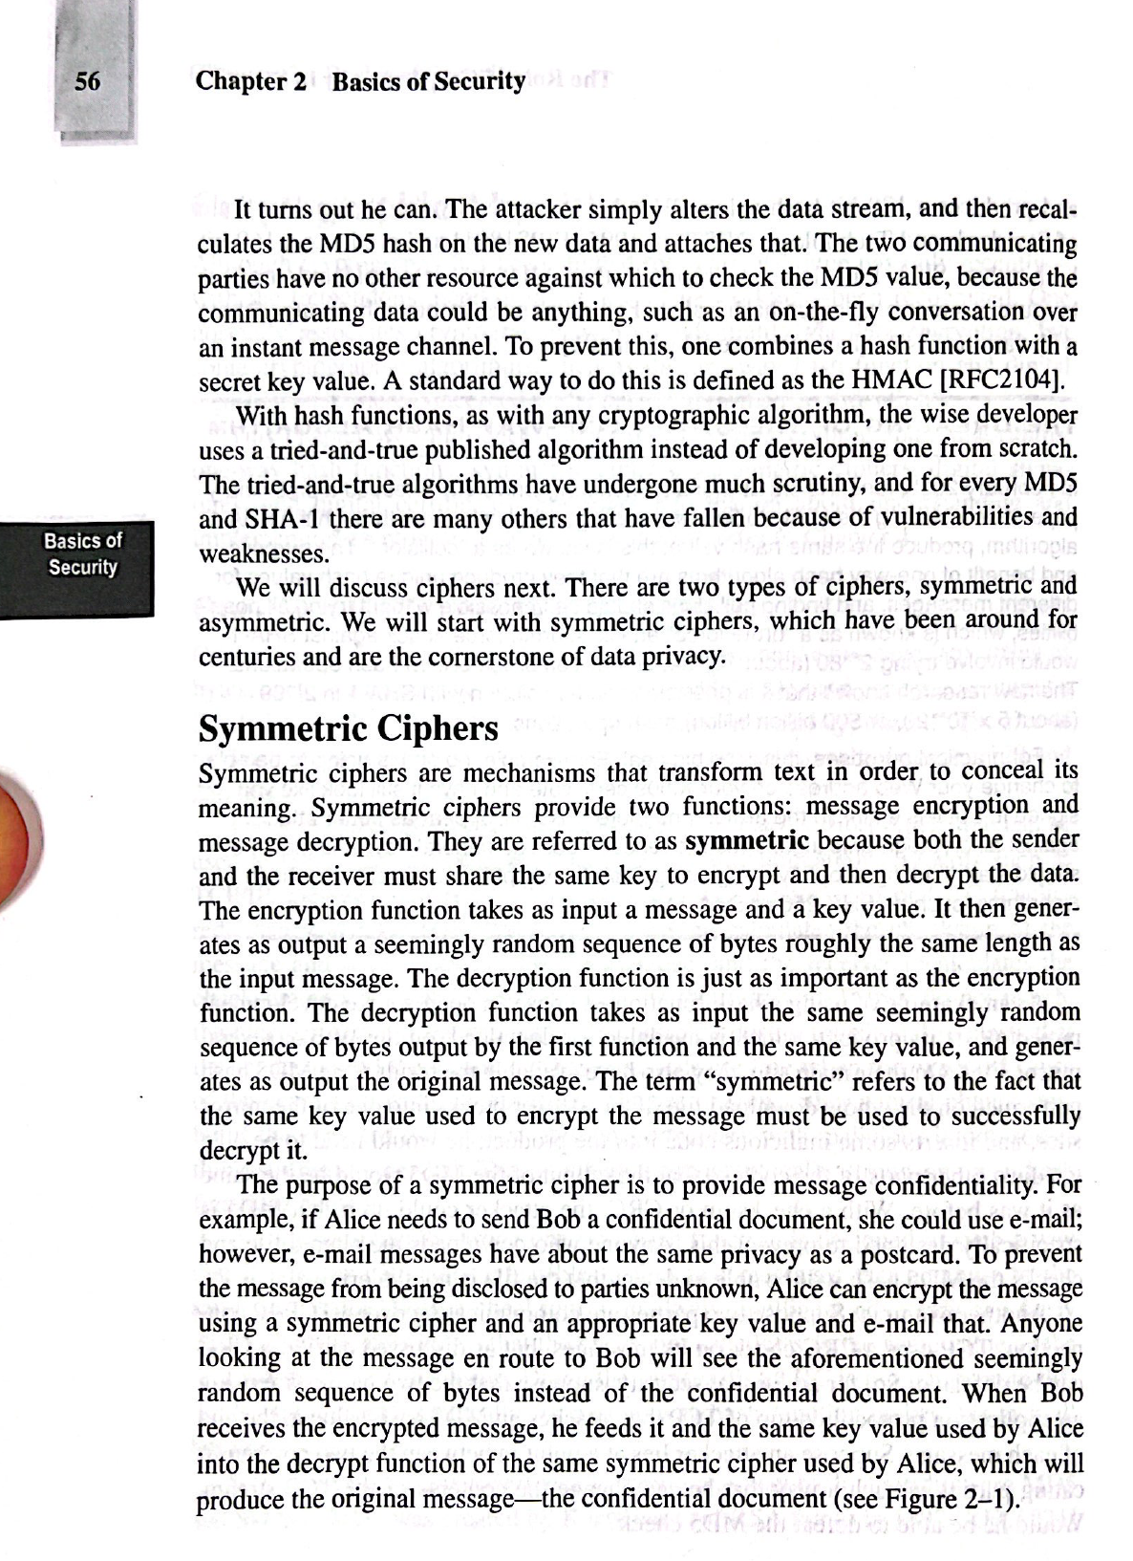

Slide 13
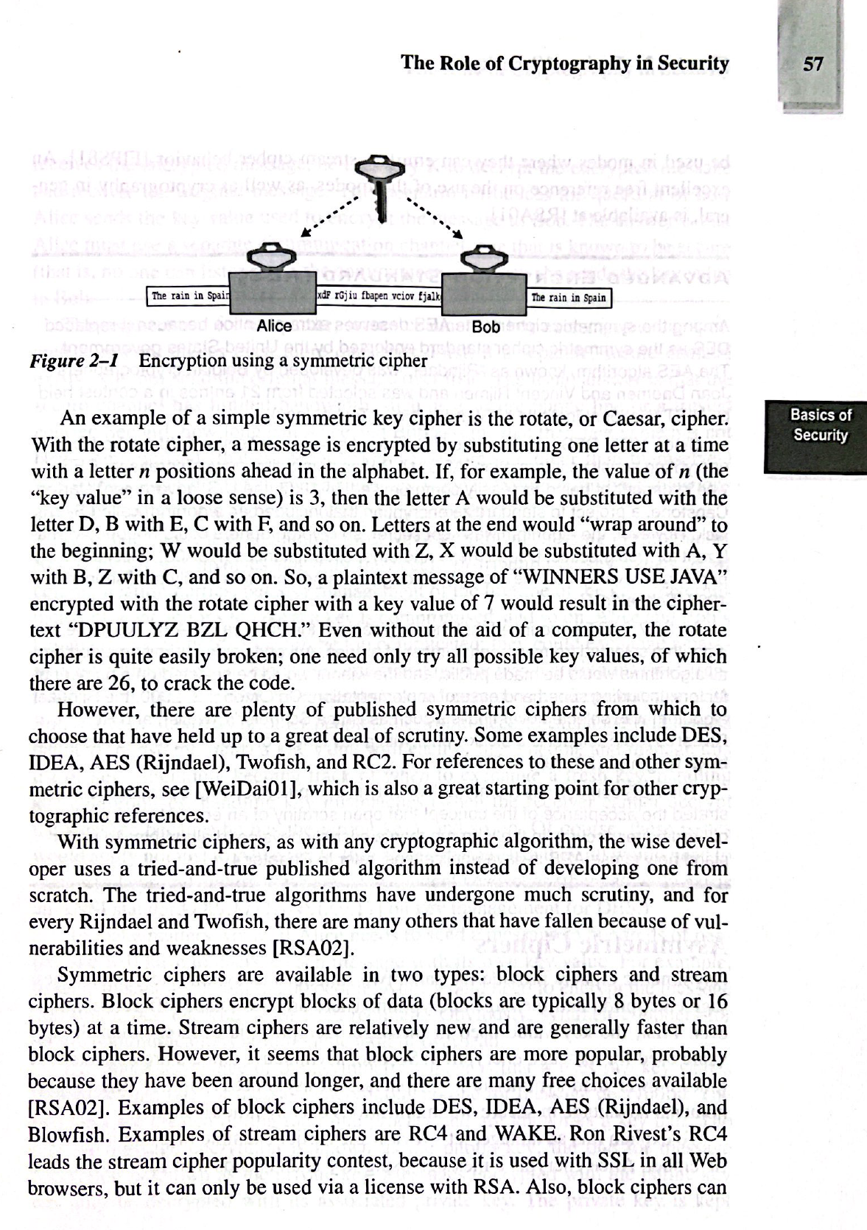

Slide 14
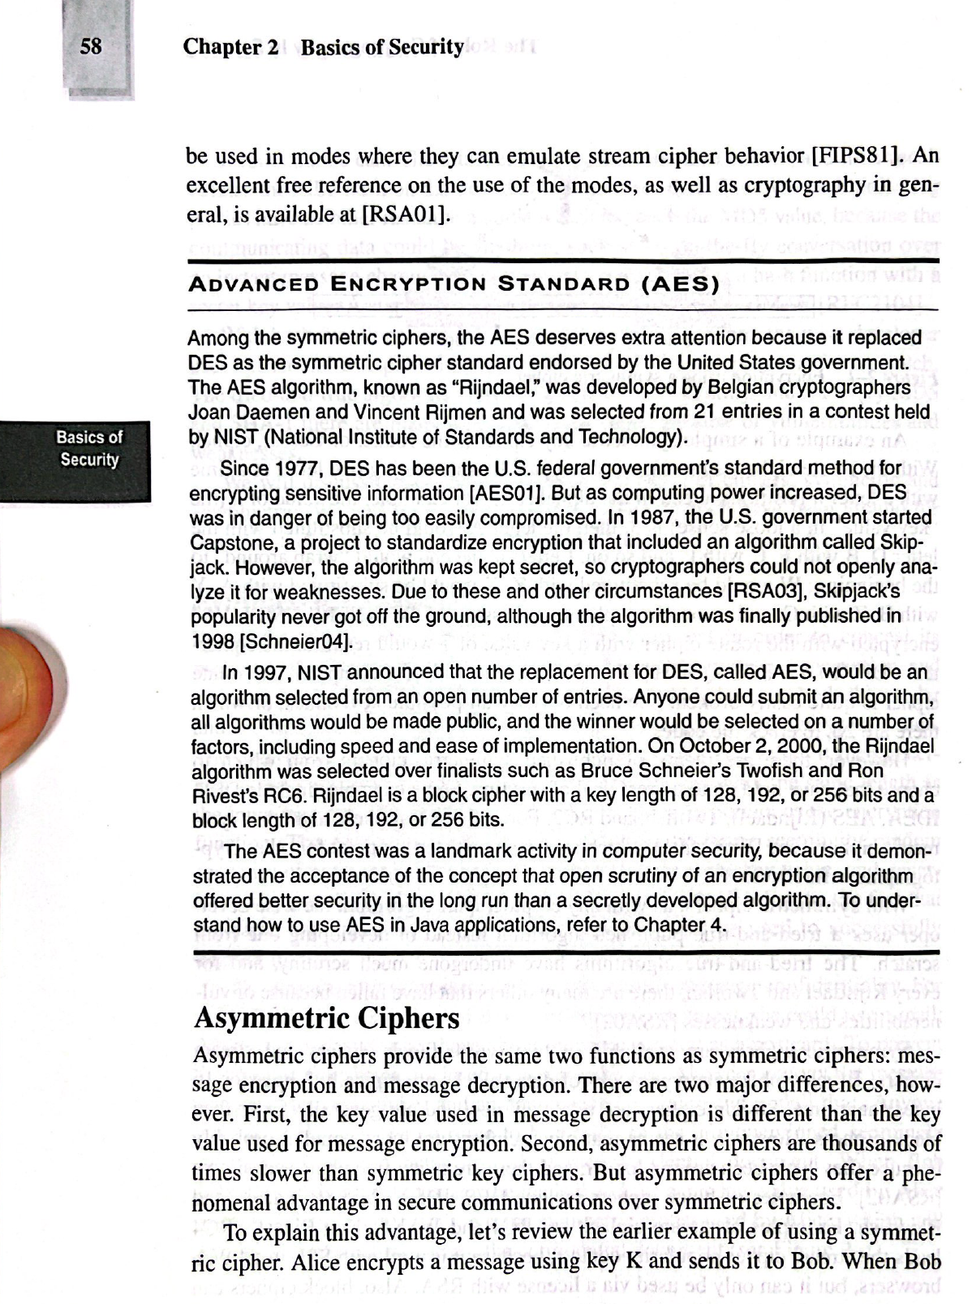

Slide 15
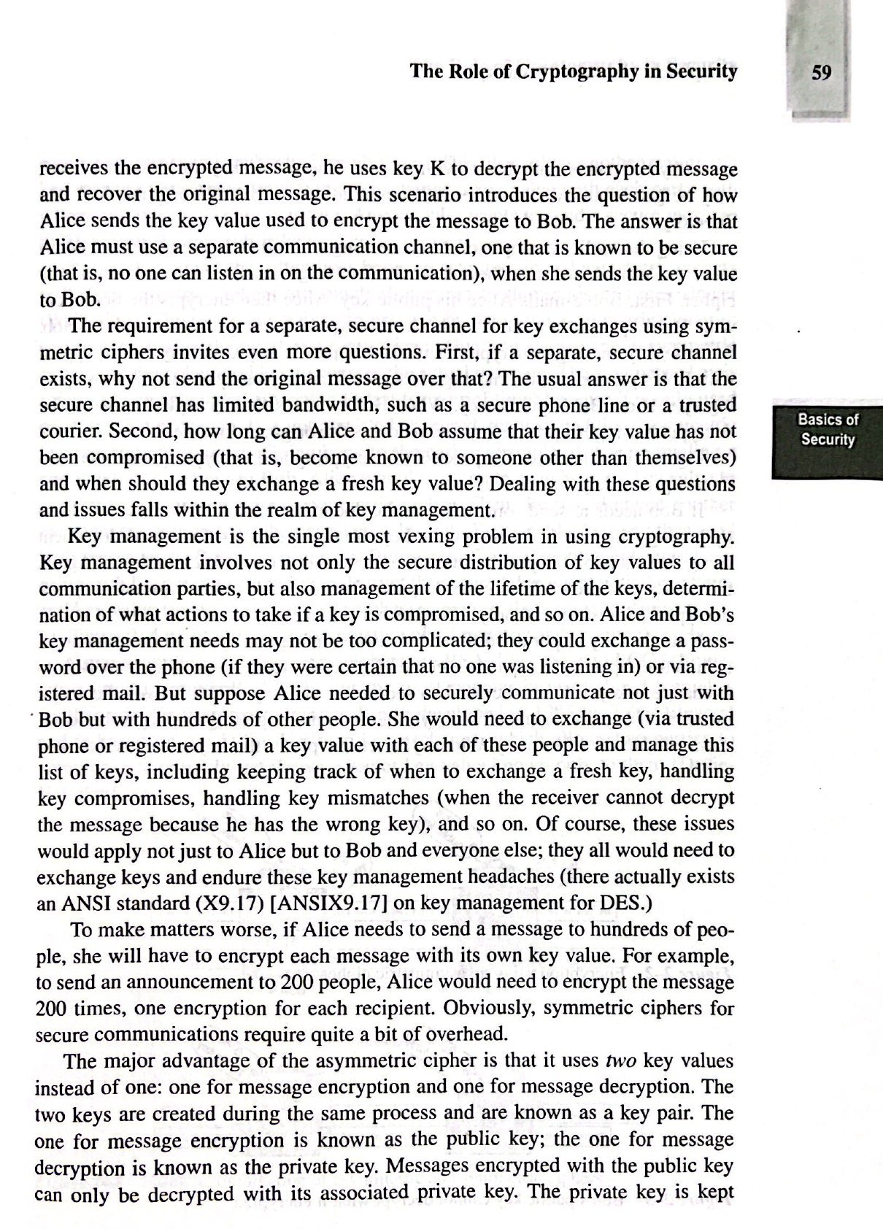

Slide 16
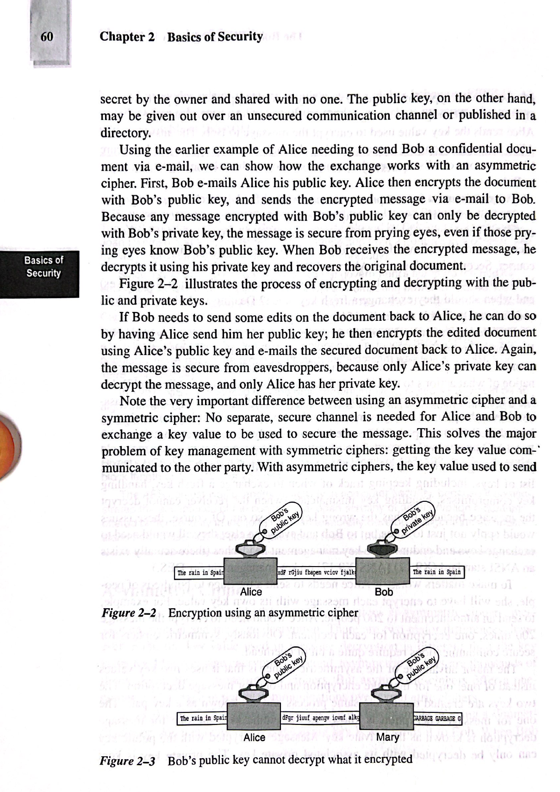

Slide 17
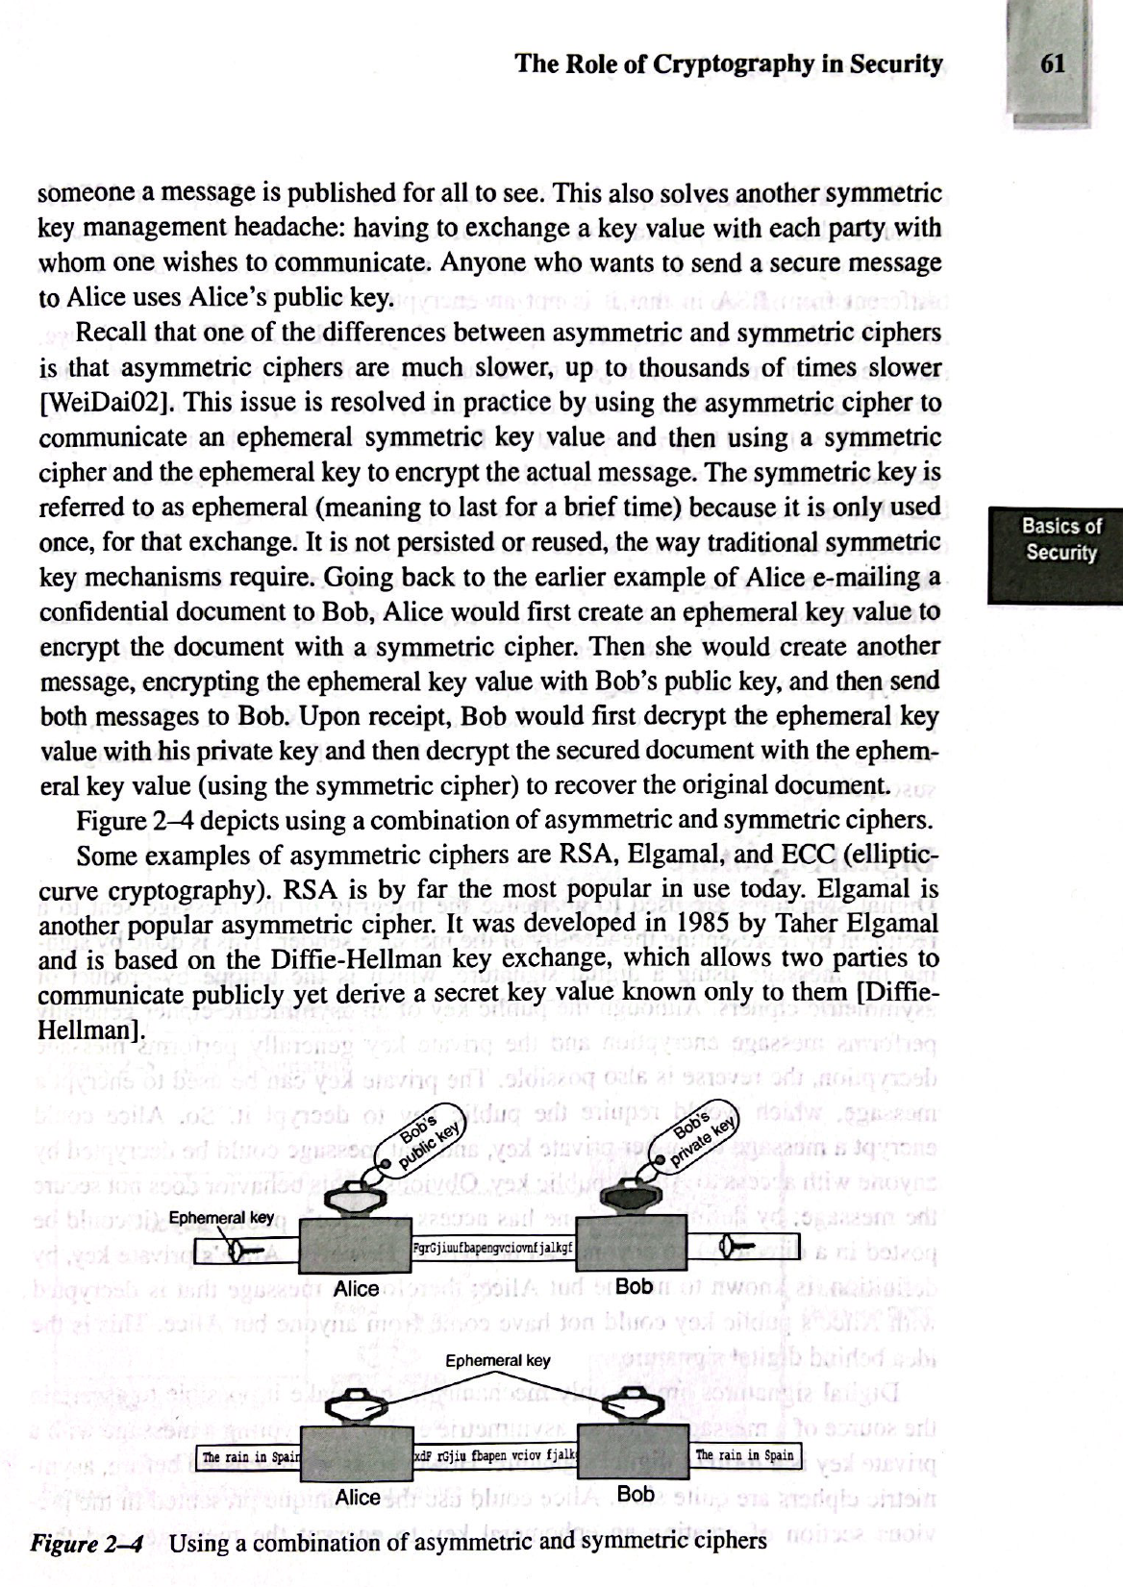

Slide 18
package org.hkps.mavenproject3;
import java.security.InvalidAlgorithmParameterException;
import java.security.NoSuchAlgorithmException;
import java.security.SecureRandom;
import java.security.spec.InvalidKeySpecException;
import java.security.spec.KeySpec;
import java.util.Base64;
import java.util.logging.Level;
import java.util.logging.Logger;
import javax.crypto.BadPaddingException;
import javax.crypto.Cipher;
import javax.crypto.IllegalBlockSizeException;
import javax.crypto.NoSuchPaddingException;
import javax.crypto.SecretKey;
import javax.crypto.SecretKeyFactory;
import javax.crypto.spec.IvParameterSpec;
import javax.crypto.spec.PBEKeySpec;
import javax.crypto.spec.SecretKeySpec;
import javax.management.openmbean.InvalidKeyException;
public class Mavenproject3 {
public static void main(String[] args) {
try {
String name = "Peter";
String encryptedString = encrypt("AES/CBC/PKCS5Padding", name, getKeyFromPassword("password123", "xxxx"), generateIv());
System.out.println(encryptedString);
String decryptedString = decrypt("AES/CBC/PKCS5Padding", encryptedString, getKeyFromPassword("password123", "xxxx"), generateIv());
System.out.println(decryptedString);
} catch (Exception ex) {
Logger.getLogger(Mavenproject3.class.getName()).log(Level.SEVERE, null, ex);
}
}
public static SecretKey getKeyFromPassword(String password, String salt)
throws NoSuchAlgorithmException, InvalidKeySpecException {
SecretKeyFactory factory = SecretKeyFactory.getInstance("PBKDF2WithHmacSHA256");
KeySpec spec = new PBEKeySpec(password.toCharArray(), salt.getBytes(), 65536, 256);
SecretKey secret = new SecretKeySpec(factory.generateSecret(spec)
.getEncoded(), "AES");
return secret;
}
public static IvParameterSpec generateIv() {
byte[] iv = new byte[16];
new SecureRandom().nextBytes(iv);
return new IvParameterSpec(iv);
}
public static String encrypt(String algorithm, String input, SecretKey key, IvParameterSpec iv) throws NoSuchPaddingException, NoSuchAlgorithmException,
InvalidAlgorithmParameterException, InvalidKeyException,
BadPaddingException, IllegalBlockSizeException, java.security.InvalidKeyException {
Cipher cipher = Cipher.getInstance(algorithm);
cipher.init(Cipher.ENCRYPT_MODE, key, iv);
byte[] cipherText = cipher.doFinal(input.getBytes());
return Base64.getEncoder()
.encodeToString(cipherText);
}
public static String decrypt(String algorithm, String cipherText, SecretKey key,
IvParameterSpec iv) throws NoSuchPaddingException, NoSuchAlgorithmException,
InvalidAlgorithmParameterException, InvalidKeyException,
BadPaddingException, IllegalBlockSizeException, java.security.InvalidKeyException {
Cipher cipher = Cipher.getInstance(algorithm);
cipher.init(Cipher.DECRYPT_MODE, key, iv);
byte[] plainText = cipher.doFinal(Base64.getDecoder()
.decode(cipherText));
return new String(plainText);
}
}

Slide 19
功課3
自己網上揾一個”對稱加密”和”非對稱加密”試下

Slide 20
Thank you
香港編程學會
Peter
96554595

