Slide 1

LeetCode訓練營
第2堂
香港編程學會
Collection

Slide 2
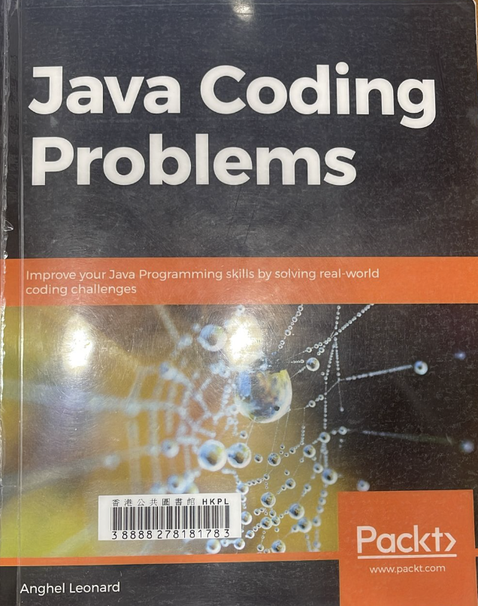

Slide 3
https://github.com/quantrpeter/leetcode-lesson-2

Slide 4
Sort an Array
Find Element
Check array equal or mismatch
Compare two arrays lexicographically
Create stream from array
Min, max, avg of array
Filling array
Reverse array
Next greater element (NGE)
Changing array size
Create unmodifiable/immutable collections
Mapping a default value
Computing whether absent/present in a map
Removal from a map
Comparing two maps
Copying hashmap
Sorting a map
Remove elements that match a predicate
Convert collection into array
Filtering a collection
Replace element
Thread safe
Trie
Tuple
Union Find
Bloom filter

Slide 5
Sort an array
import java.util.Arrays;
import org.junit.Test;
public class SortArray {
@Test
public void test() {
int x[] = {1, 43, 2, -23, 10};
Arrays.sort(x);
for (int temp : x) {
System.out.println(temp);
}
}
}

Slide 6
Comparator
import java.util.Arrays;
import java.util.Comparator;
import org.junit.Test;
public class Test1 {
@Test
public void test() {
int x[] = {1, 43, 2, -23, 10};
Arrays.sort(x);
for (int temp : x) {
System.out.println(temp);
}
String names[] = {"peter", "mary", "susan"};
Arrays.sort(names, new Comparator<String>() {
@Override
public int compare(String o1, String o2) {
System.out.println(o1 + " == " + o2);
if (o1.equals("mary") || o1.equals("susan")) {
return -1;
}
return 0;
}
});
for (String temp : names) {
System.out.println(temp);
}
}
}

Slide 7
Comparator
Person person1 = new Person("Peter", 44, "hk");
Person person2 = new Person("Susan", 12, "usa");
Person person3 = new Person("John", 13, "hk");
Person people[] = {person1, person2, person3};
Arrays.sort(people, new Comparator<Person>() {
@Override
public int compare(String o1, String o2) {
System.out.println(o1 + " == " + o2);
if (o1.equals("mary") || o1.equals("susan")) {
return -1;
}
return 0;
}
});
for (String temp : names) {
System.out.println(temp);
}

Slide 8
Find Element
import java.util.Arrays;
import org.junit.Test;
public class FindElement {
@Test
public void test() {
String x[] = {"peter", "mary", "susan"};
Arrays.sort(x);
System.out.println(Arrays.binarySearch(x, "peter"));
System.out.println(Arrays.binarySearch(x, "mary"));
System.out.println(Arrays.binarySearch(x, "susan"));
}
}

Slide 9
Check array equal or mismatch
import java.util.Arrays;
import org.junit.Test;
public class CheckArrayEquals {
@Test
public void test() {
String x3[] = {"peter", "mary", "susan", "11", "22", "33"};
String x4[] = {"peter", "susan", "mary", "11", "22", "33"};
System.out.println(Arrays.equals(x3, 3, 5, x4, 3, 5));
}
}

Slide 10
Check array equal or mismatch
import java.util.Arrays;
import org.junit.Test;
public class CheckArrayEquals {
@Test
public void test() {
String x3[] = {"peter", "mary", "susan", "11", "22", "33"};
String x4[] = {"peter", "susan", "mary", "11", "22", "33"};
System.out.println(Arrays.mismatch(x3, x4));
}
}

Slide 11
Compare two arrays lexicographically
0 = if two arrays are same in exact same order
<0 = first array is lexicographically less then the second array
>0 = first array is lexicographically greater then the second array
import java.util.Arrays;
import org.junit.Test;
public class CheckArrayLexicographically {
@Test
public void test() {
int x1[] = {1, 2, 3, 4, 5};
int x2[] = {1, 2, 3, 4, 1};
System.out.println(Arrays.compare(x1, x2));
}
}

Slide 12
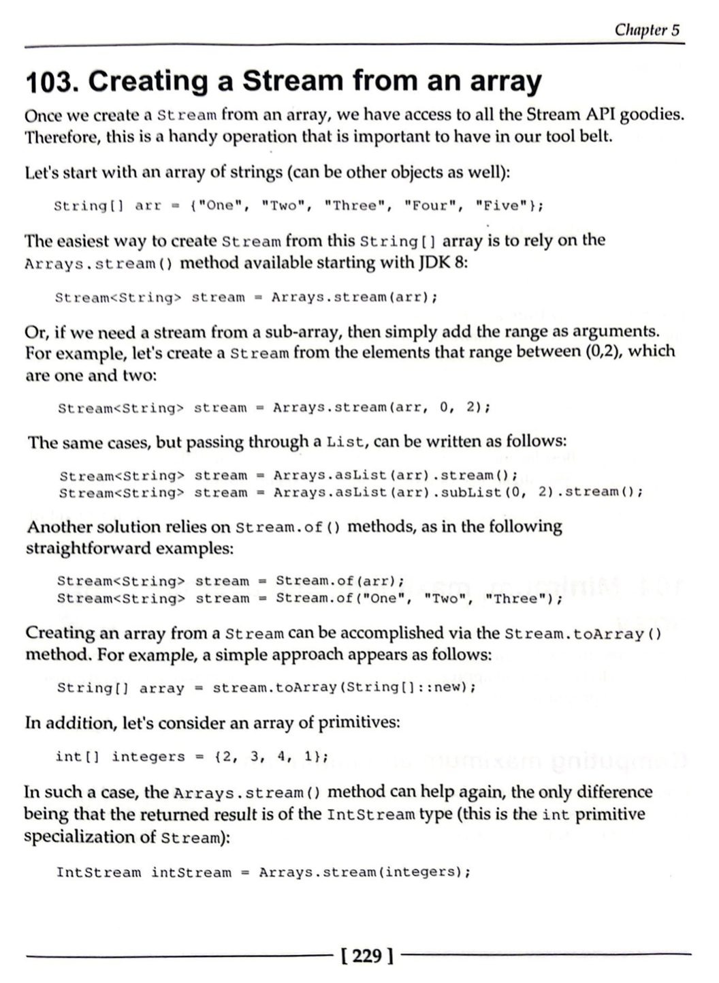
Create stream from array

Slide 13
Min, max, avg of array
import java.util.Arrays;
import org.junit.Test;
public class MaxMinAvg {
@Test
public void test() {
int x1[] = {1, 2, 3, 4, 5};
System.out.println(Arrays.stream(x1).max().getAsInt());
System.out.println(Arrays.stream(x1).min().getAsInt());
System.out.println(Arrays.stream(x1).average().getAsDouble());
}
}

Slide 14
Reverse an array
import java.util.stream.IntStream;
import org.junit.Test;
public class ReverseArray {
@Test
public void test() {
int x1[] = {1, 2, 3, 4, 5};
int reversed[] = IntStream.rangeClosed(1, x1.length).map(i -> x1[x1.length - i]).toArray();
for (int temp : reversed) {
System.out.println(temp);
}
}
}

Slide 15
Filling an array
import java.util.Arrays;
import org.junit.Test;
public class ReverseArray {
@Test
public void test() {
int x1[] = new int[10];
Arrays.fill(x1, 10);
}
}

Slide 16
Change array size
import java.util.Arrays;
import org.junit.Test;
public class ChangeArraySize {
@Test
public void test() {
int x1[] = new int[3];
Arrays.fill(x1, 10);
x1 = Arrays.copyOf(x1, 5);
for (int temp : x1) {
System.out.println(temp);
}
}
}

Slide 17
功課 : Make it work
1
2
3
1
2
3
1
2
3
1
2
3
3
2
1
3
2
1
3
2
1

Slide 18

Thank You

