Slide 1

Python
Machine Learning
Lesson 4
Peter Cheung

Slide 2
Error Rate 誤差

Slide 4
1
-1
3
Error = 3 +(-3) +1 + (-1)
-3

Slide 5
1
-1
Absolute Error 絶對誤差
Error = 3 +(-3) +1 + (-1)
3
-3
Error = 3 +3 +1 + 1
= 8

Slide 6
1
-1
Absolute Error 絶對誤差
Error = 2.5 +(-2.5) +1 + (-1)
2.5
-2.5
Error = 2.5 +2.5 +1 + 1
= 7

Slide 7
1
-1
Square Error 平方誤差
3
Error = 3² +-3² +1² + -1²
= 9 + 9 +1 +1
= 20
-3

Slide 8
1
-1
Square Error 平方誤差
Error = 2.5² +-2.5² +1² + -1²
= 6.25 + 6.25 +1 +1
= 14.5
2.5
-2.5

Slide 9
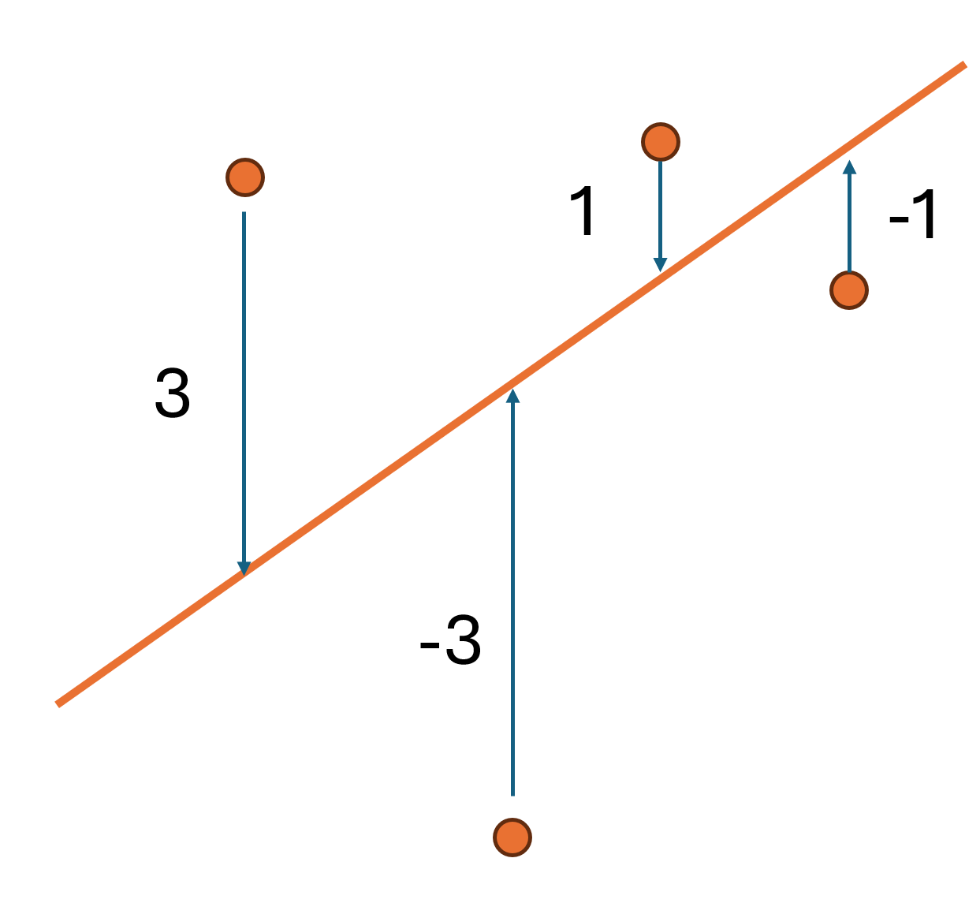
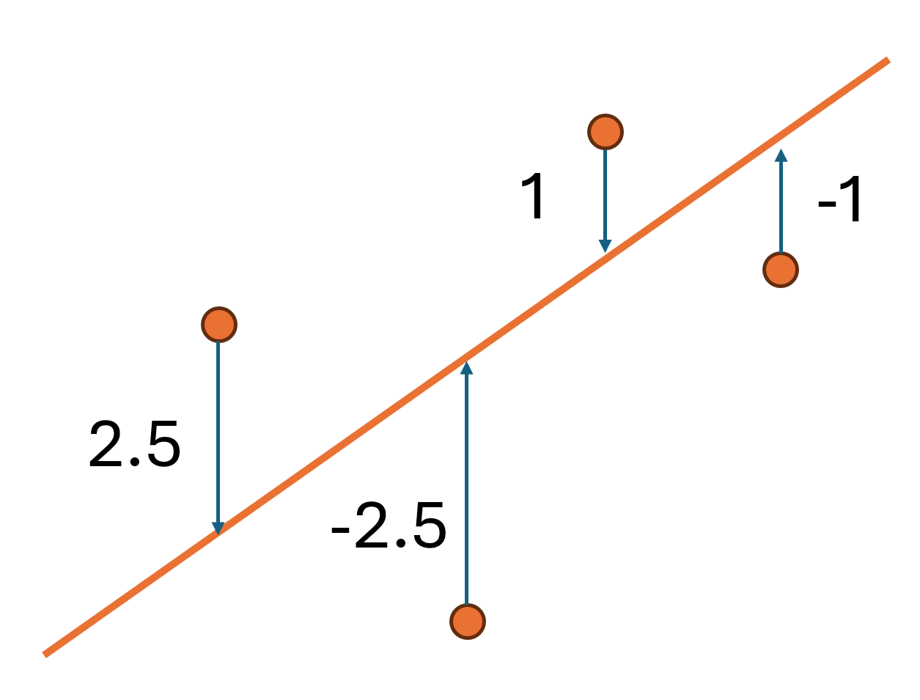
Absolute Error 絶對誤差
Square Error 平方誤差
Error = 8
Error = 20
Error = 7
Error = 14.5

Slide 10
多項式廻歸

Slide 11
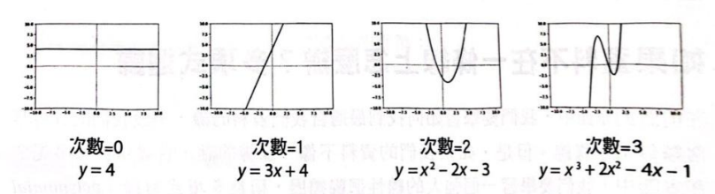
多項式廻歸

Slide 12
多項式廻歸

Slide 13
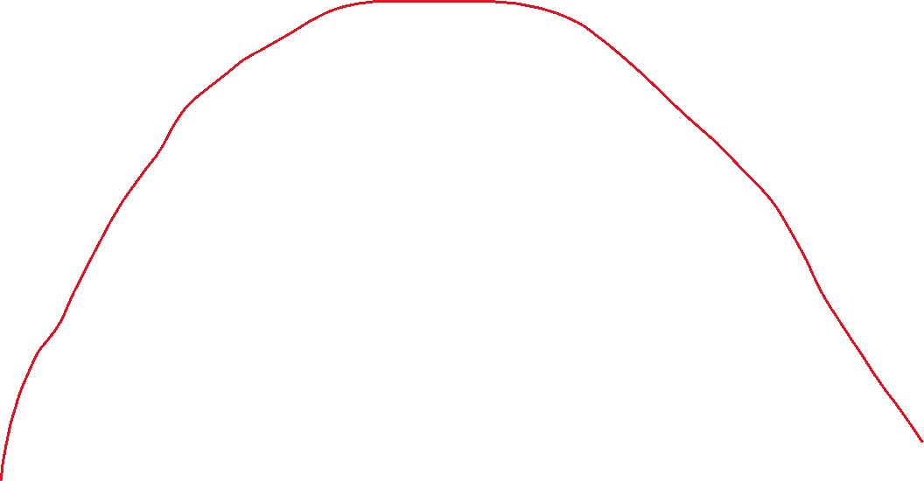
多項式廻歸

Slide 14
