Slide 1


Java第28堂
香港編程學會
Peter

Slide 2
Agenda
  JSON
  Restful api
香港編程學會

Slide 3
JSON (JavaScript Object Notation) is a lightweight data-interchange format. It is easy for humans to read and write. It is easy for machines to parse and generate. It is based on a subset of the JavaScript Programming Language Standard ECMA-262 3rd Edition - December 1999.

Slide 4
JSON Example
{"name":"John", "age":30, "car":null}
{
"name":"John",
"age":30,
"car":null
}

Slide 5
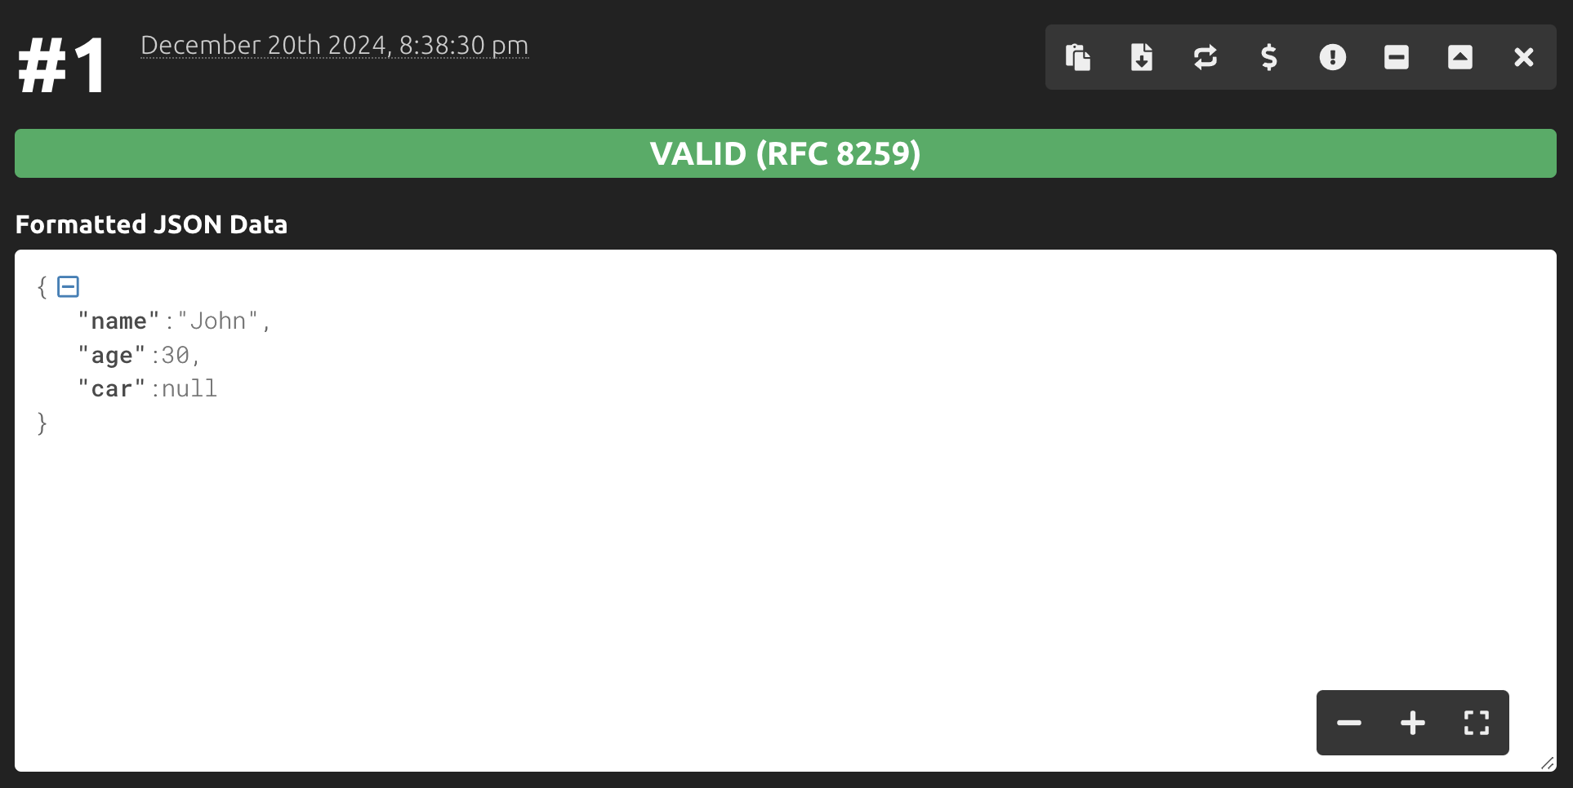
Check JSON
https://jsonformatter.curiousconcept.com/

Slide 6
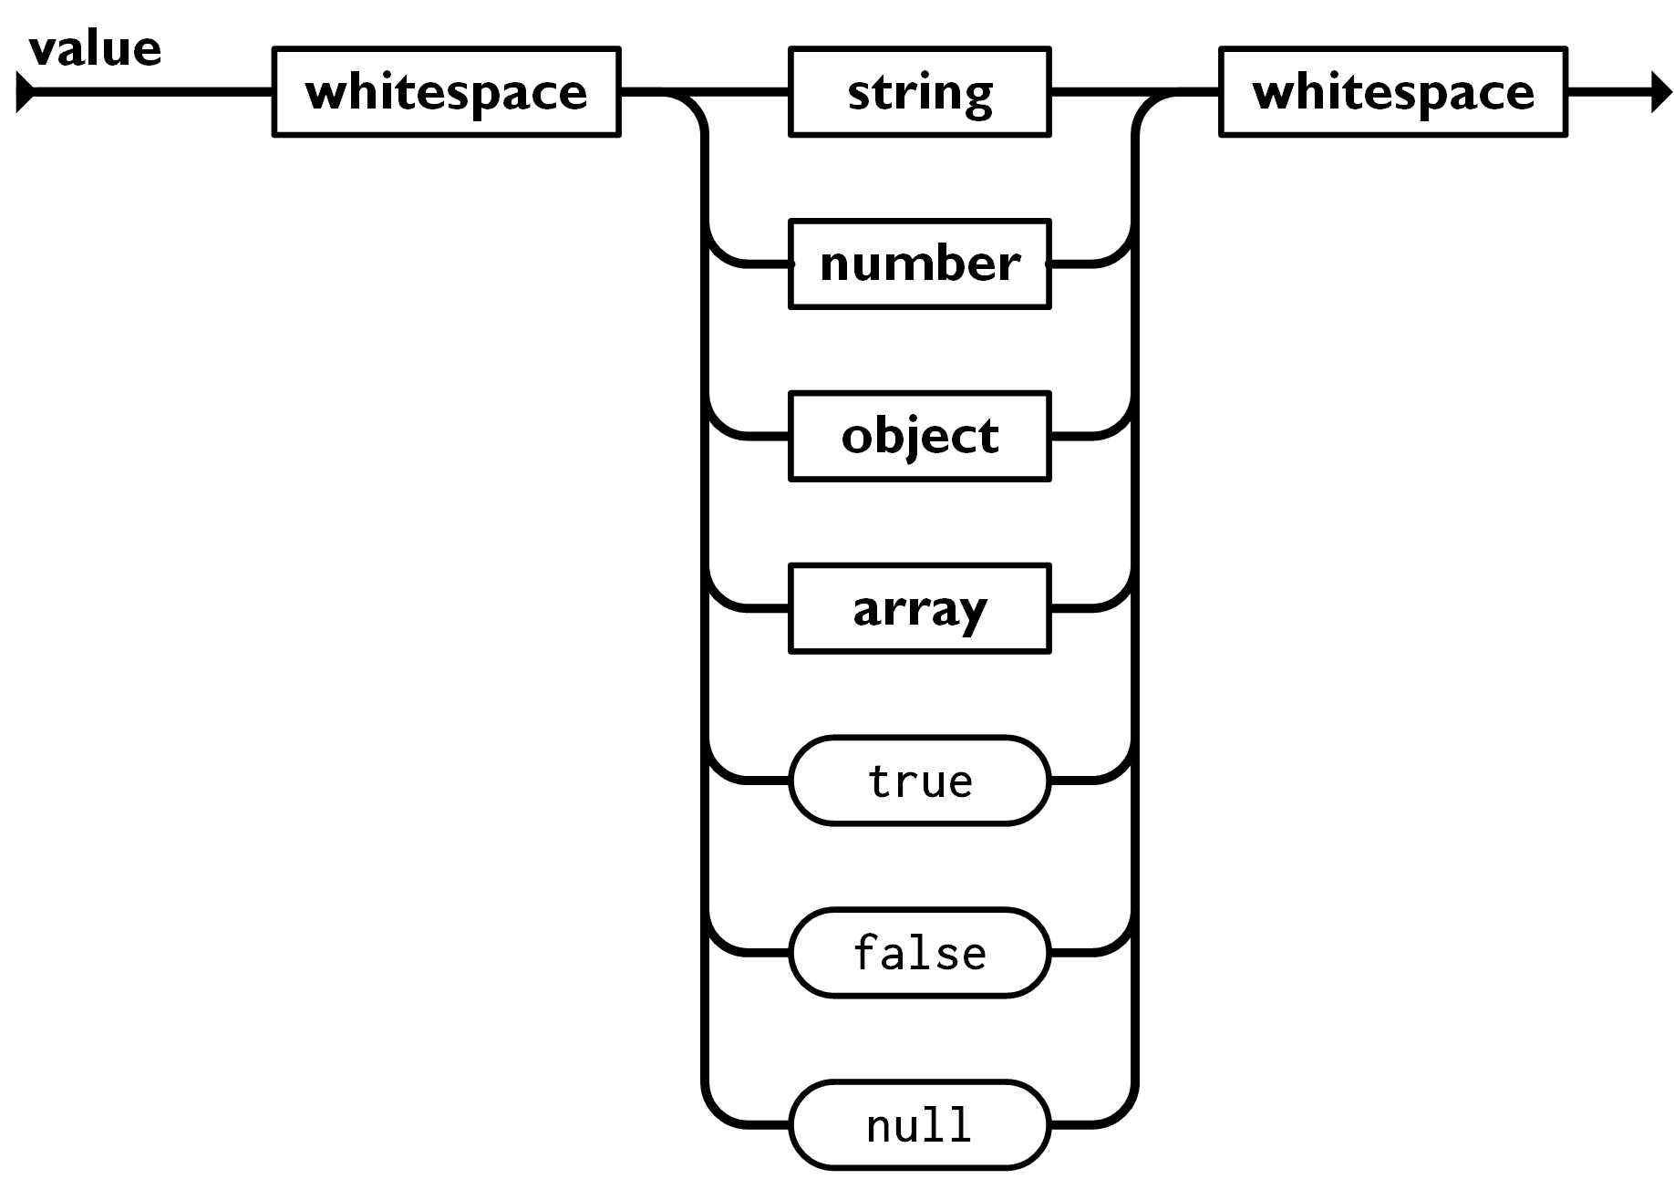
JSON Example

Slide 7
JSON Array
["Ford", "BMW", "Fiat"]
{
"name":"John",
"age":30,
"car": ["Ford", "BMW", "Fiat"]
}

Slide 8
Gson is a Java library that can be used to convert Java Objects into their JSON representation. It can also be used to convert a JSON string to an equivalent Java object. Gson can work with arbitrary Java objects including pre-existing objects that you do not have source-code of.
https://github.com/google/gson

Slide 9
Serialization
Gson gson = new Gson();
// POJO -> JSON String
String json = gson.toJson(new User(1, "Lokesh"));
// JSON String -> POJO
User user = gson.fromJson(json, User.class);

Slide 10
READ Weather
String url = "https://data.weather.gov.hk/weatherAPI/opendata/weather.php?dataType=rhrread&lang=tc";
URI uri = URI.create(url);
String json = IOUtils.toString(uri, "utf-8");
System.out.println(json);

Slide 11
READ/Write JSON
https://www.geeksforgeeks.org/parse-json-java/

Slide 12
Thank you
香港編程學會
Peter
96554595

